Slide 1





Reconstitutions climatiques sur la base d’assemblages polliniques de référence depuis le LGM en Europe
Approche multi-méthodes : transfert, régression et probabiliste
Après biomisation à calibration globale (14C radiocarbon date)
Etat d’avancement – 25 juill. 24

Slide 2
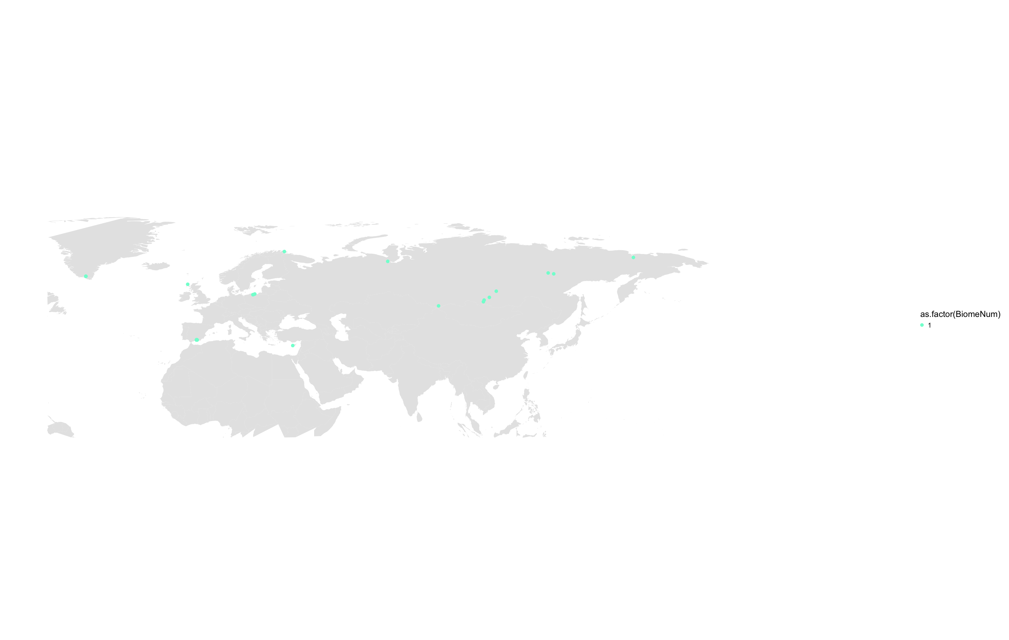
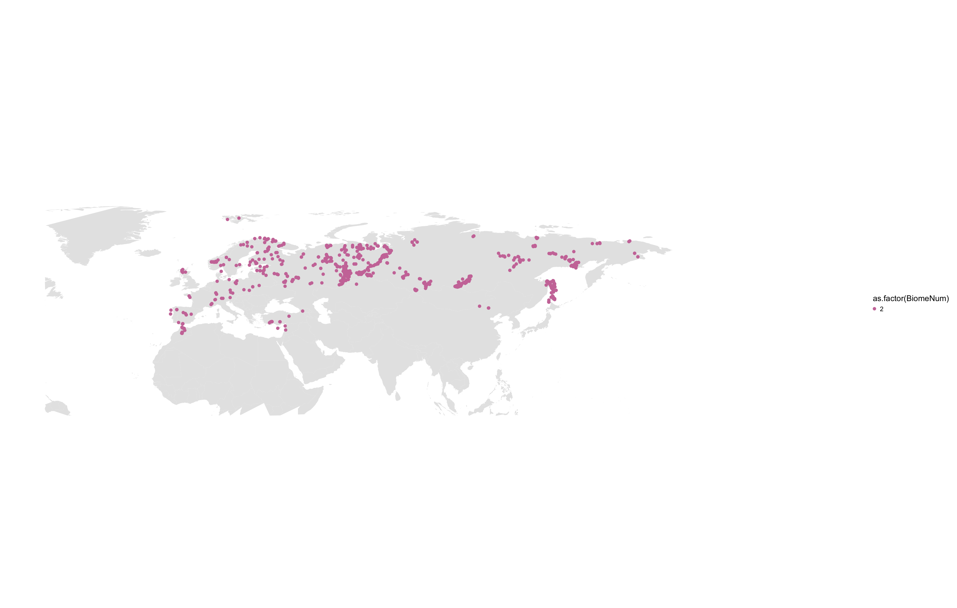
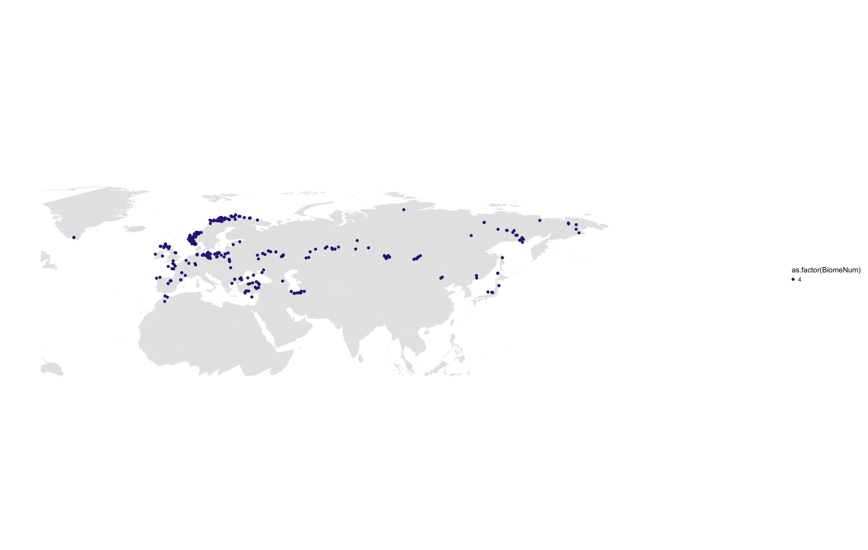
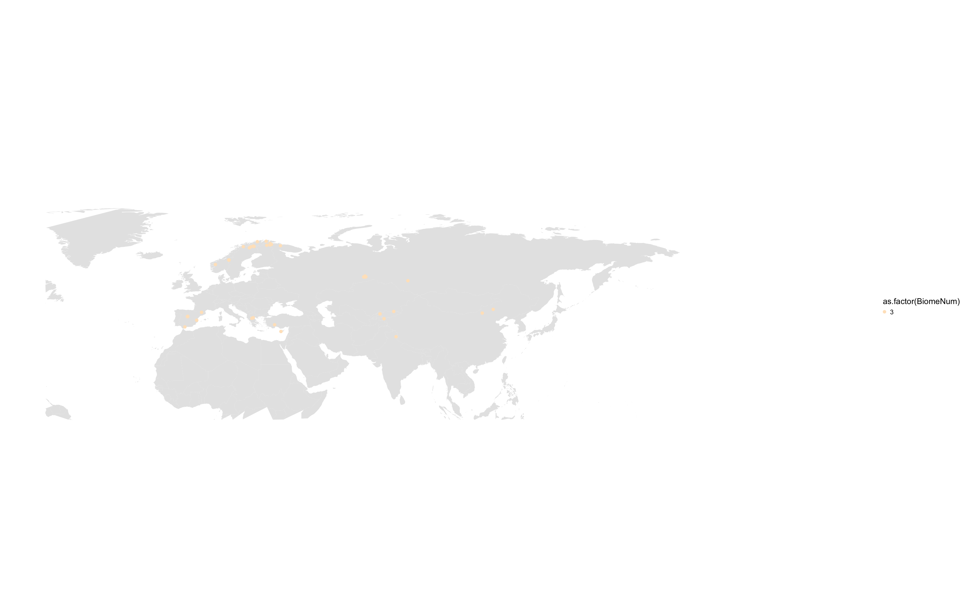
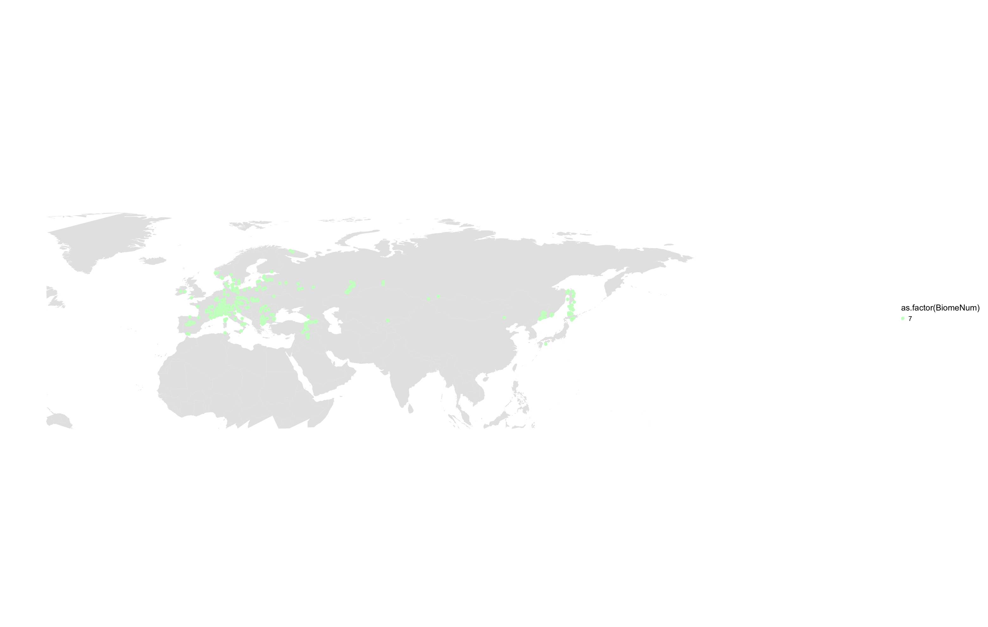
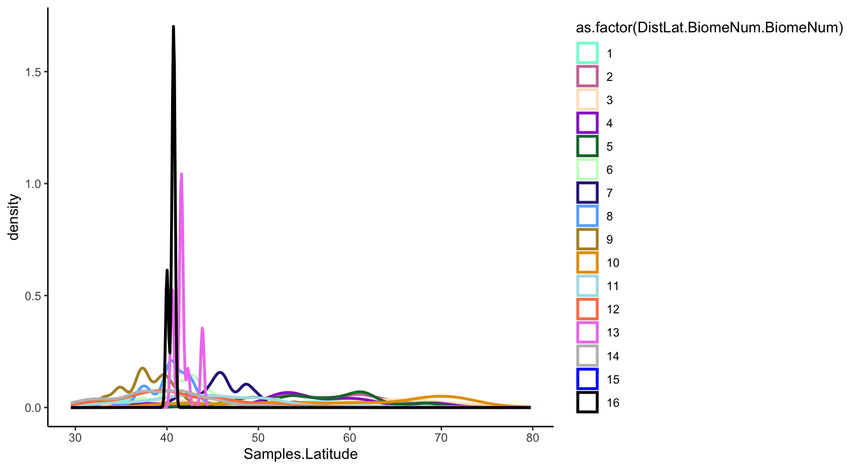
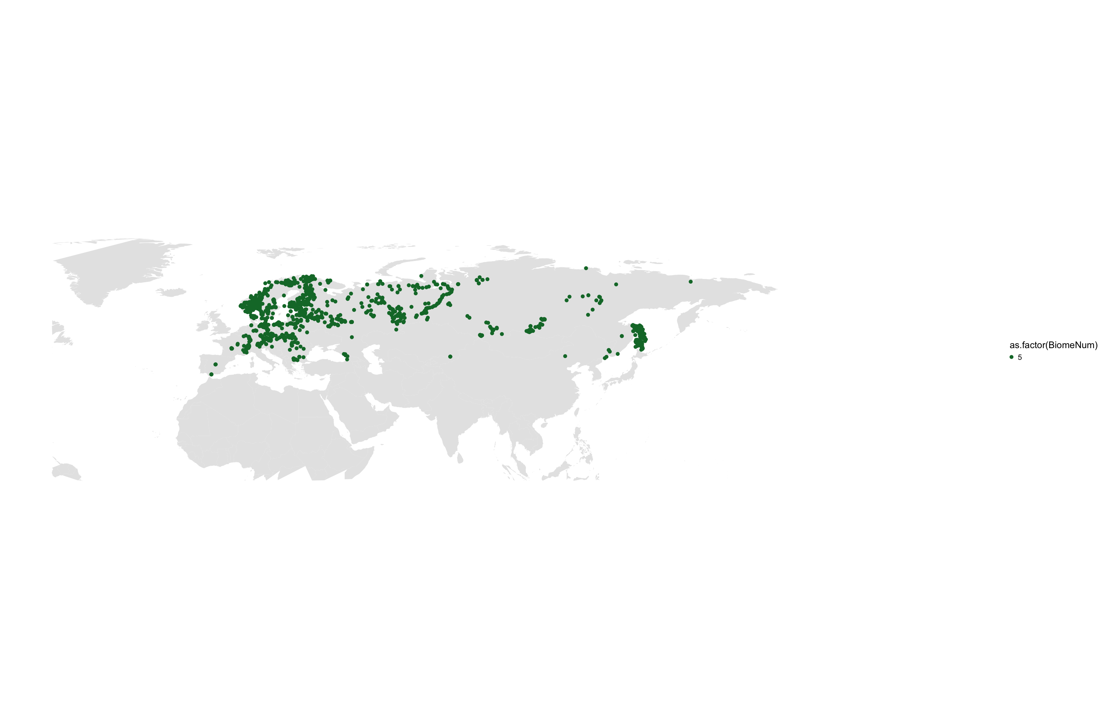
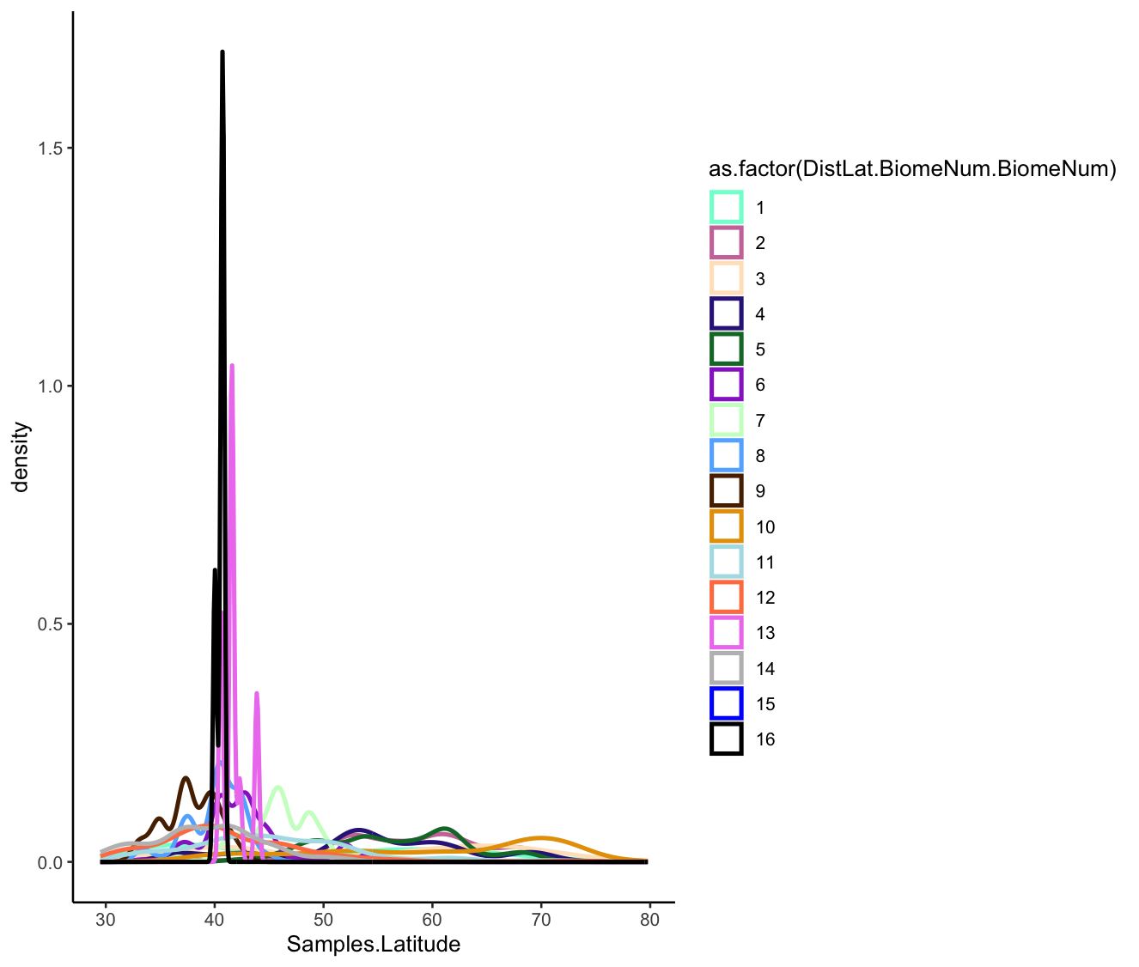
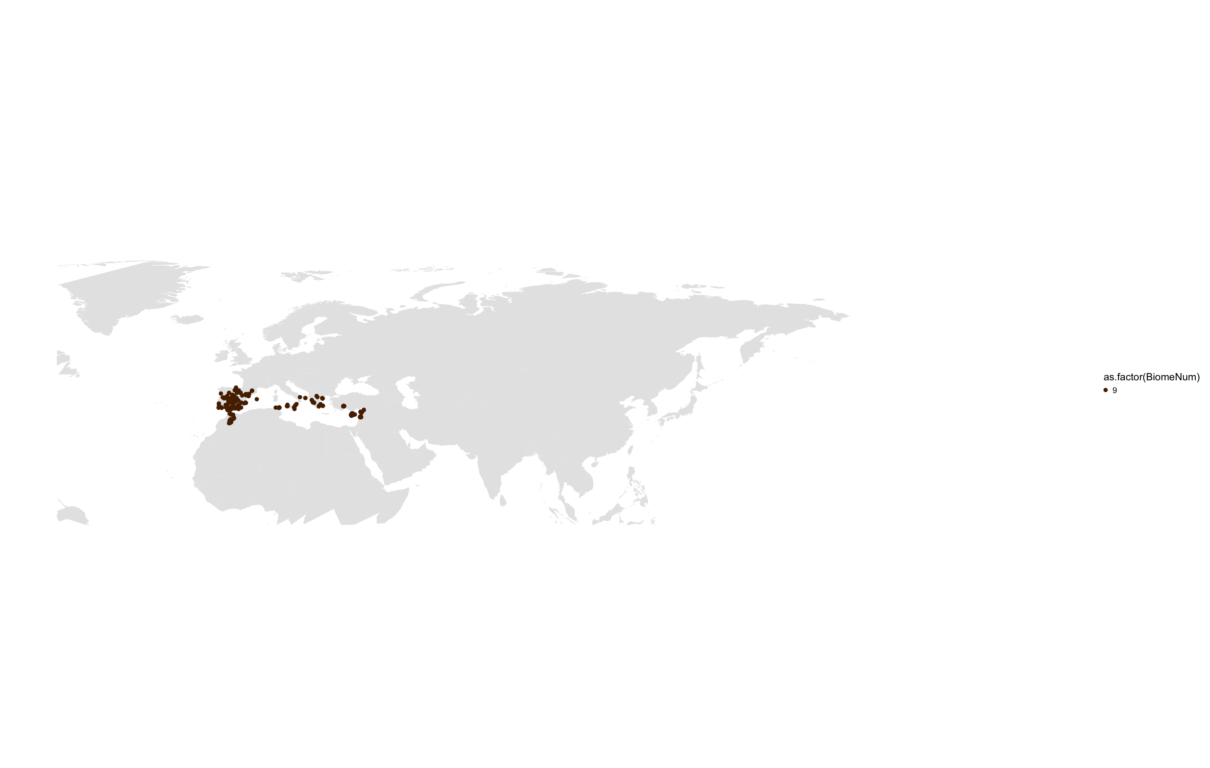
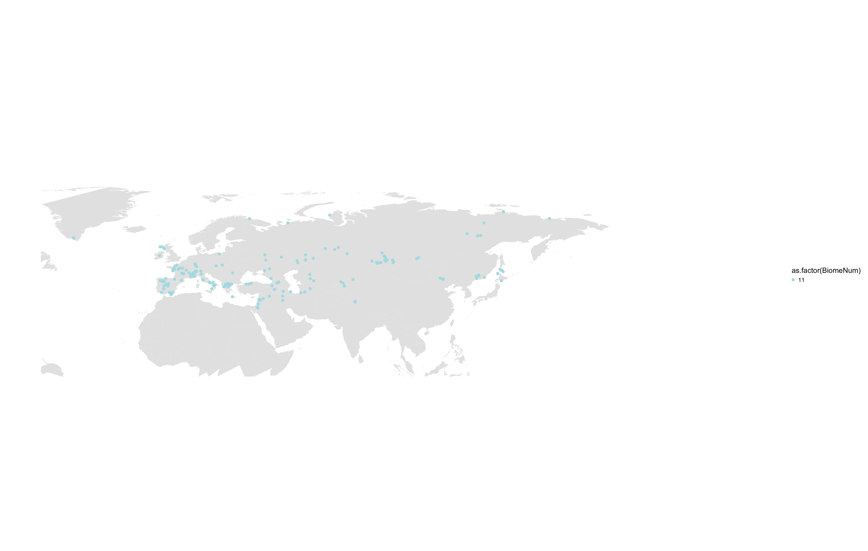
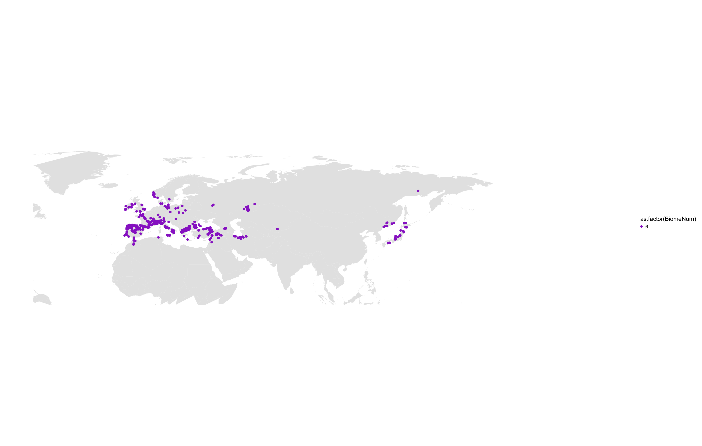
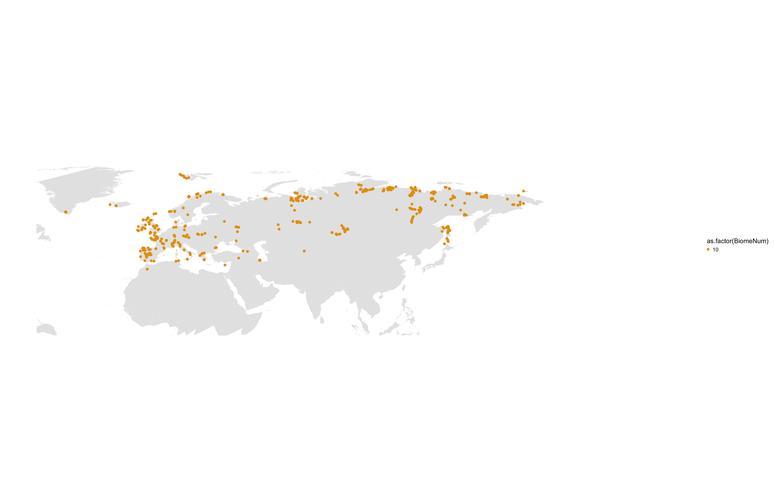
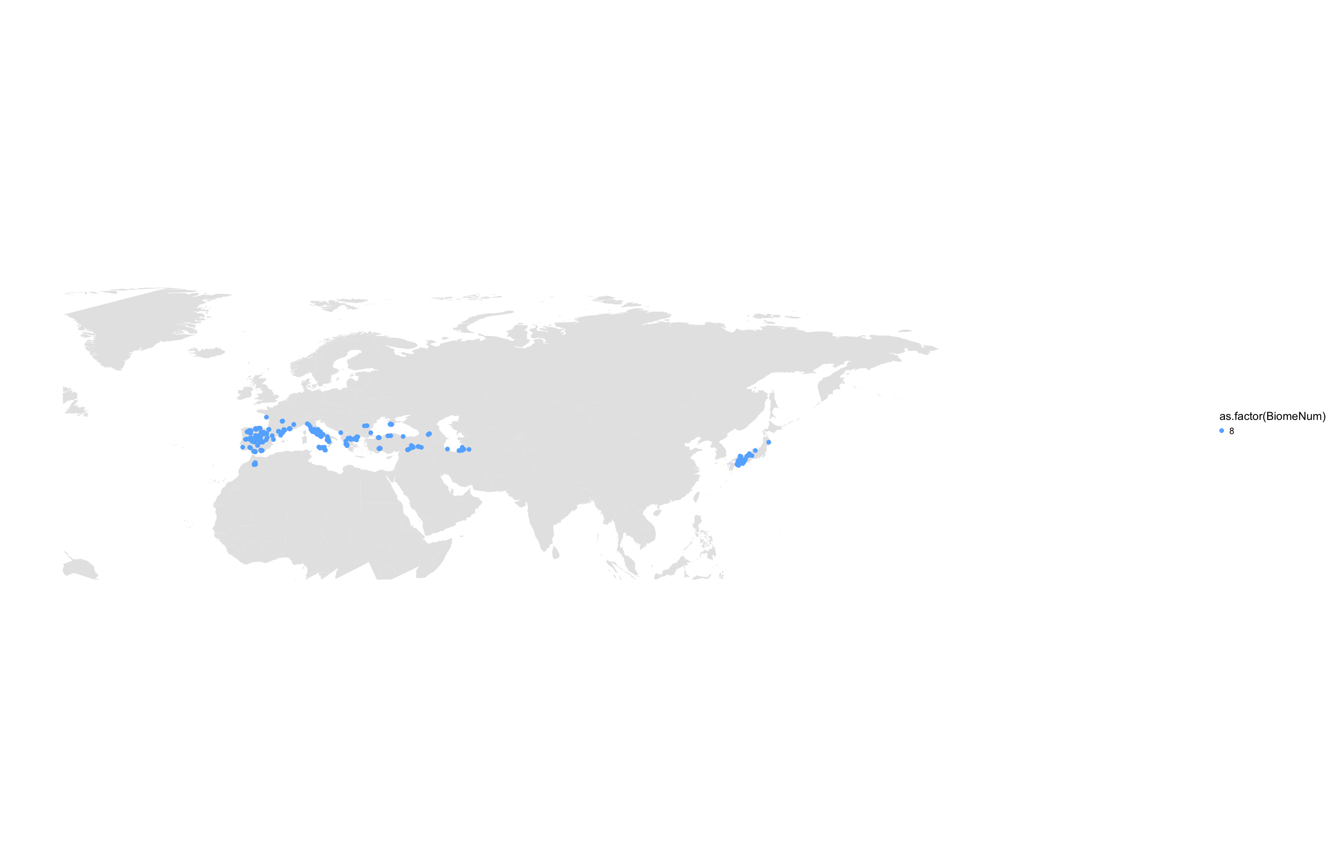
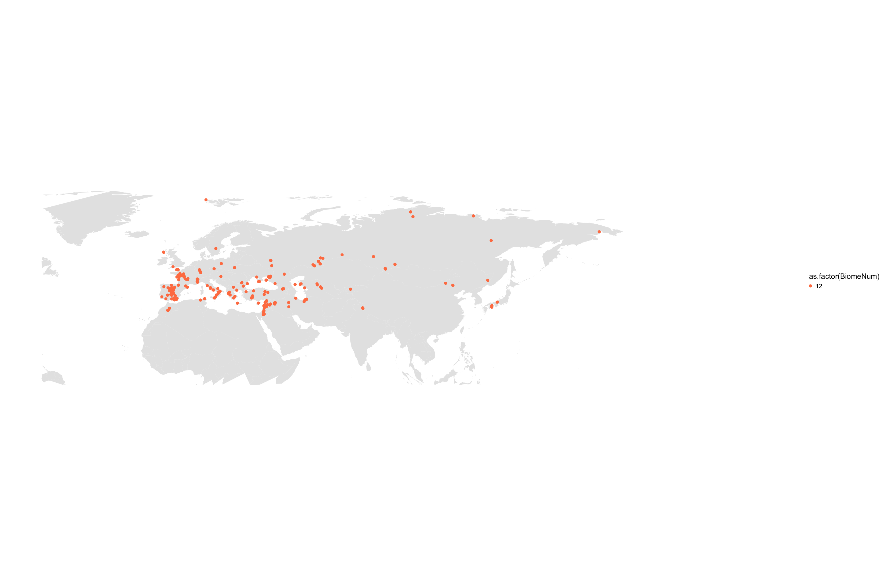
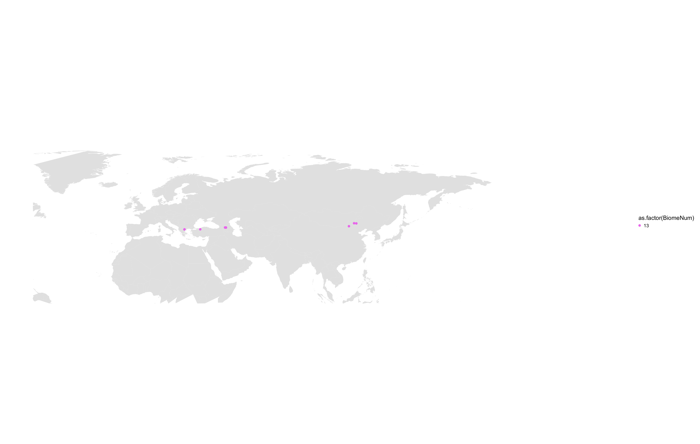
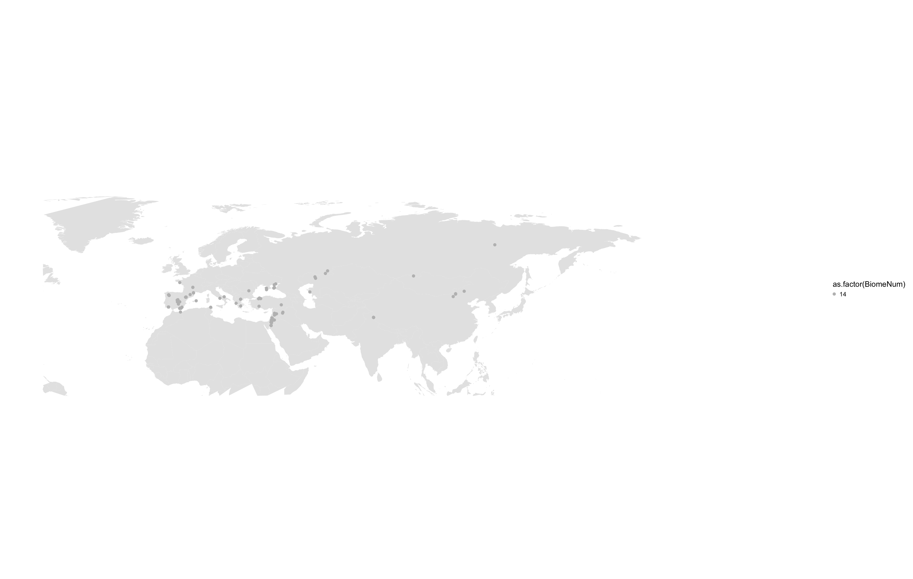
Density
0
0.5
1
1.5
30
40
50
60
70
80

Slide 3
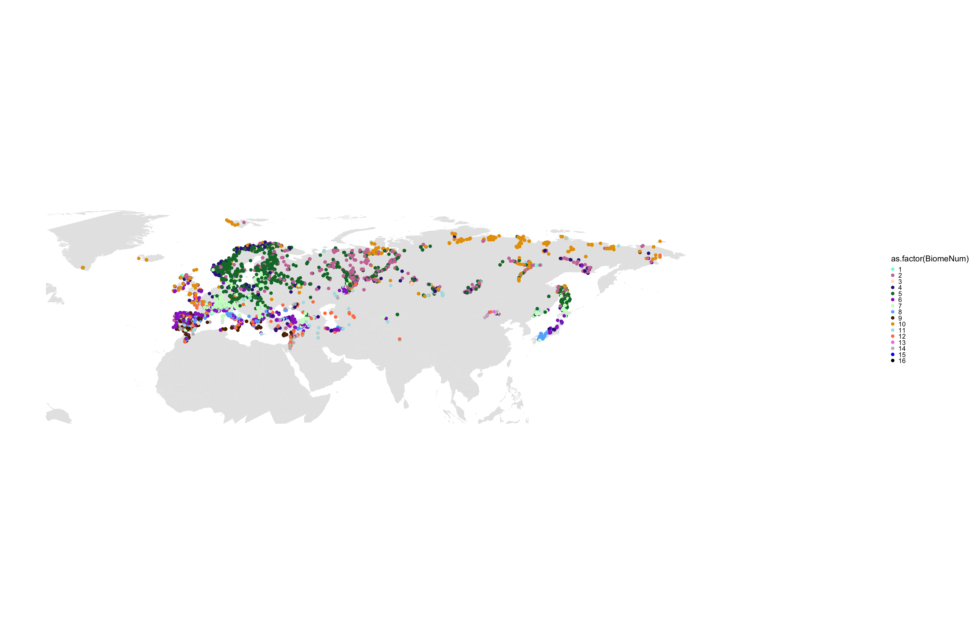
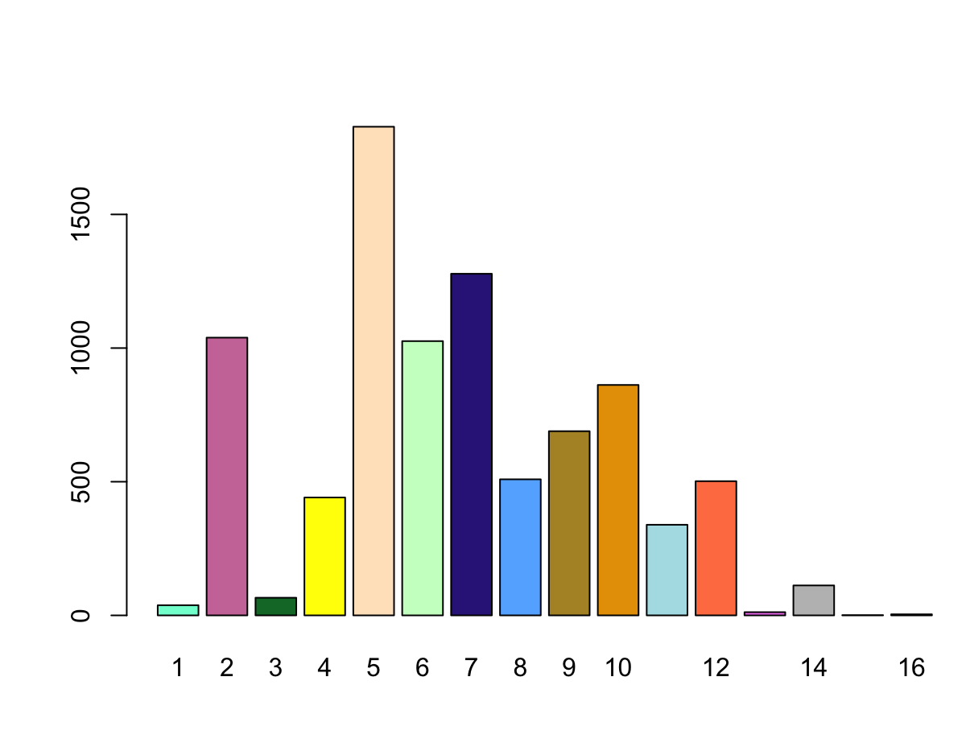
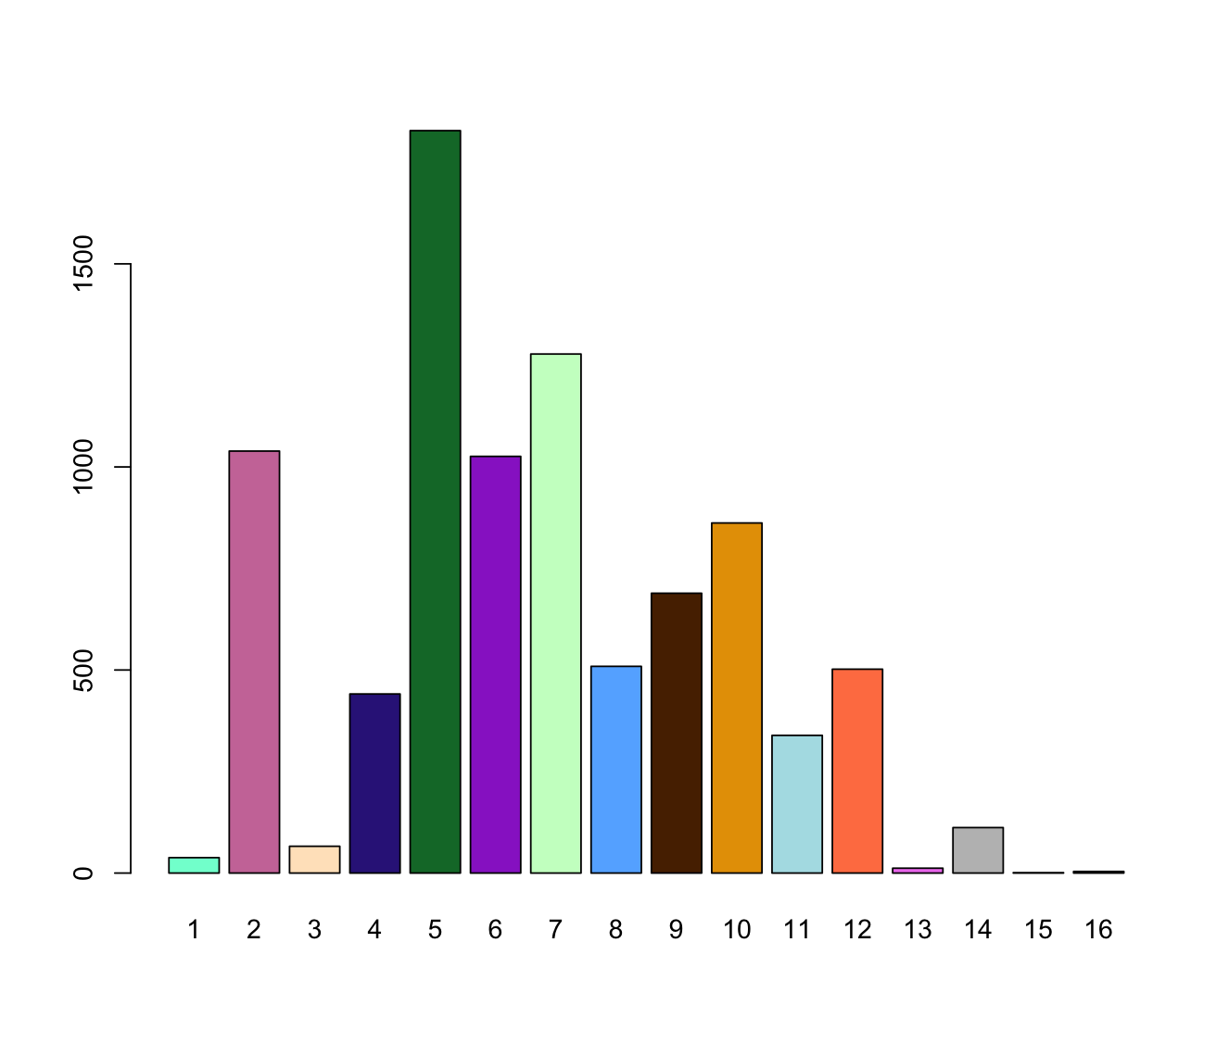
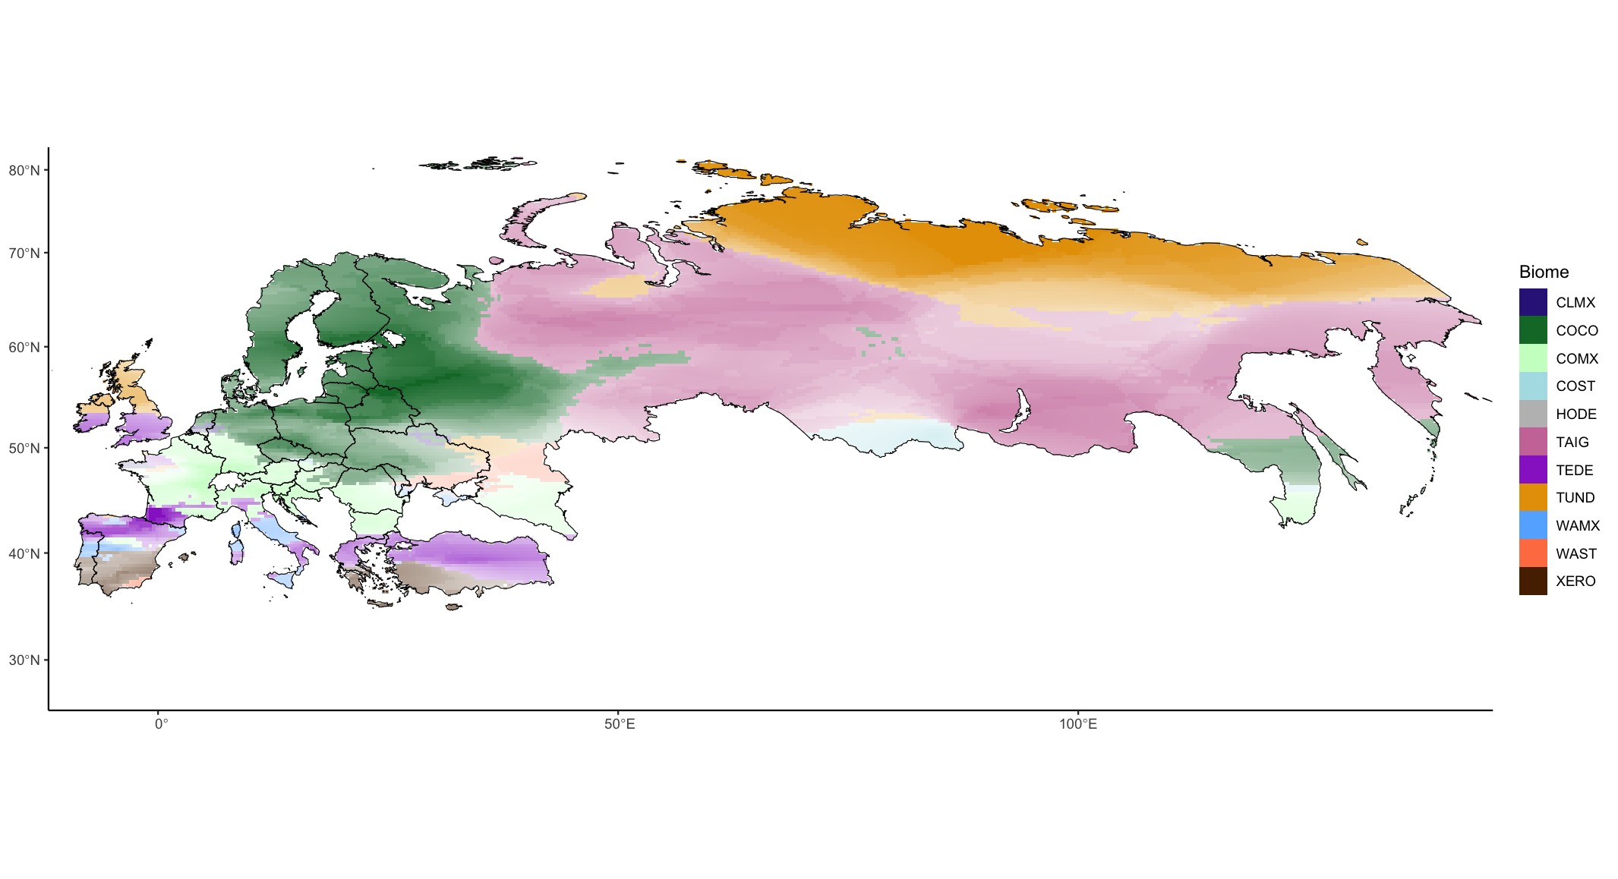
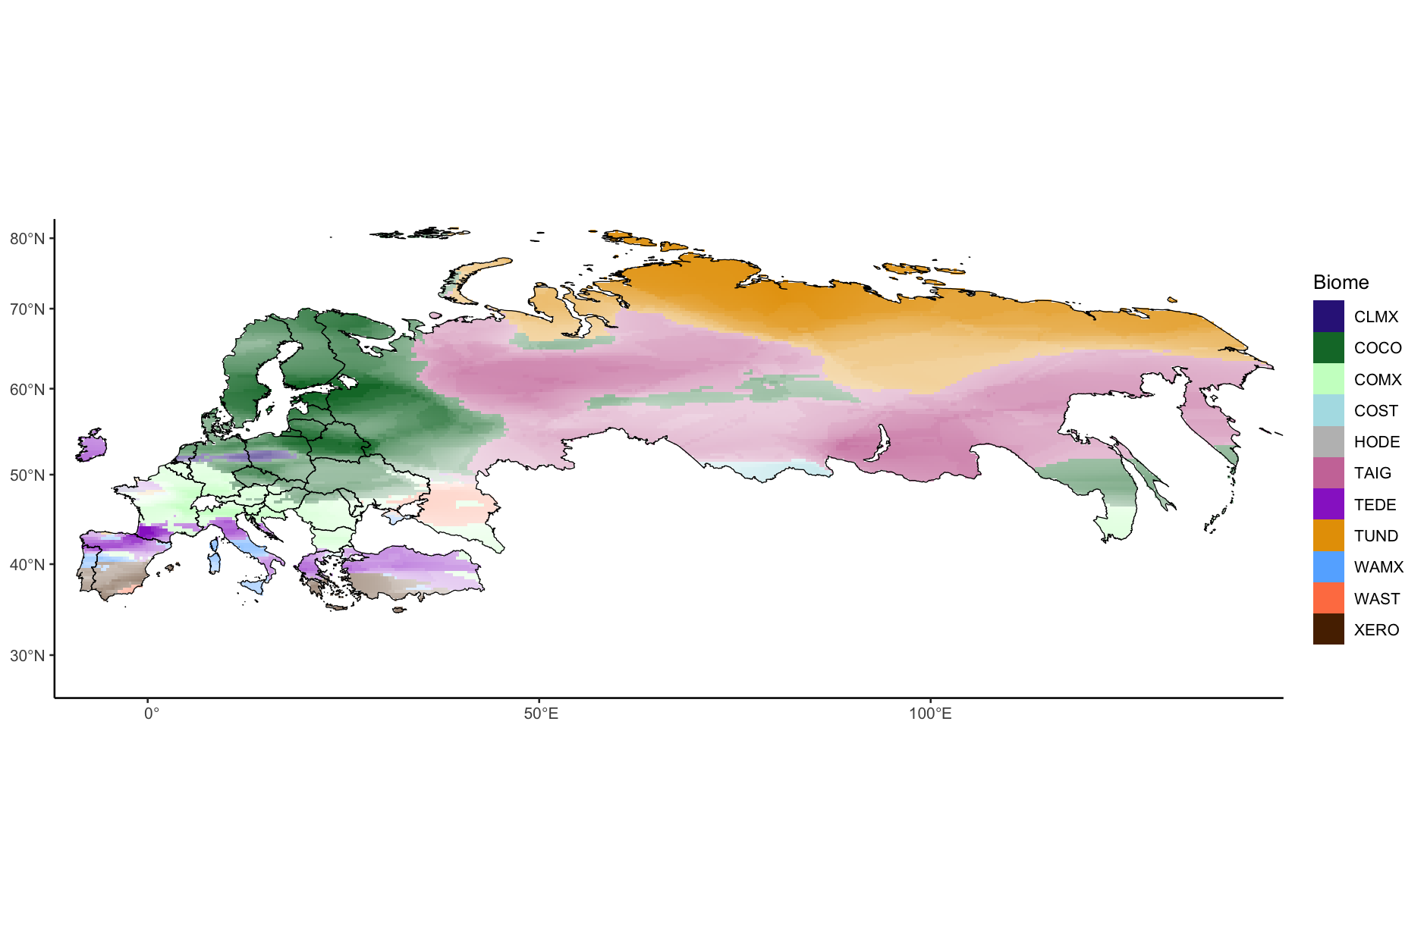
Frequency
Original biome | Original biome | Original biome
'#65B2FF’ | WAMX | Warm mixed forest
'#0020CA’ | COMX | Cool mixed forest
‘#8EA228’ | XERO | Xerophytic shrubs
‘#FF9AFD’ | COCO | Cool conifer forest
‘#BAFF35’ | TAIG | Taiga
‘#FFBA95’ | TEDE | Temperate deciduous forest
‘#FFBA35’ | CLMX | Cold mixed forest
‘#E7E718’ | TUND | Tundra
‘#E7E718’ | WAST | Warm steppes
‘#65FF9A’ | CODE | Cold desert
‘#AE7D20 | HODE | Hot desert
‘#D29E96’ | COST | Cool steppes
‘#EE82EE’ | ANTH | Anthrogenic
‘#0000FF’ | AQUA | Aquatic
‘#E7E718’ | CLDE | Cold deciduous forest
‘#F7FFCA’ | PION | Pioner

Slide 4
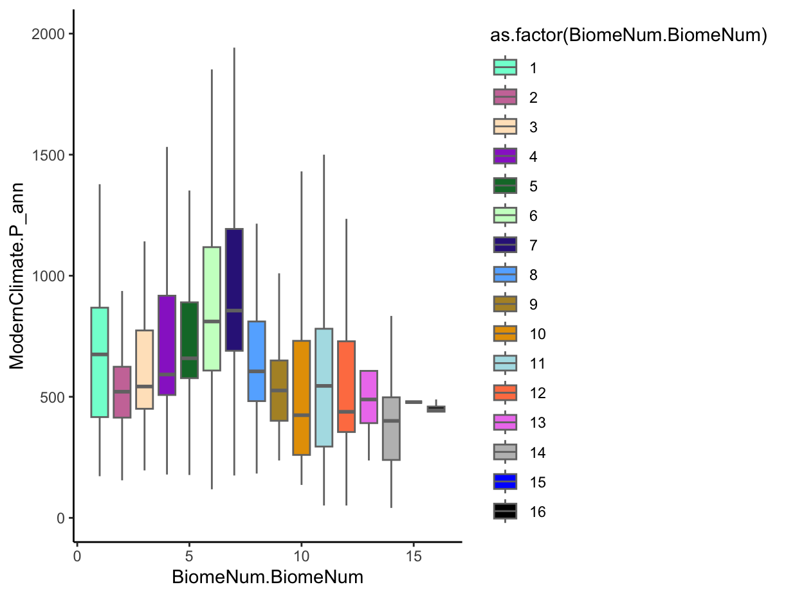
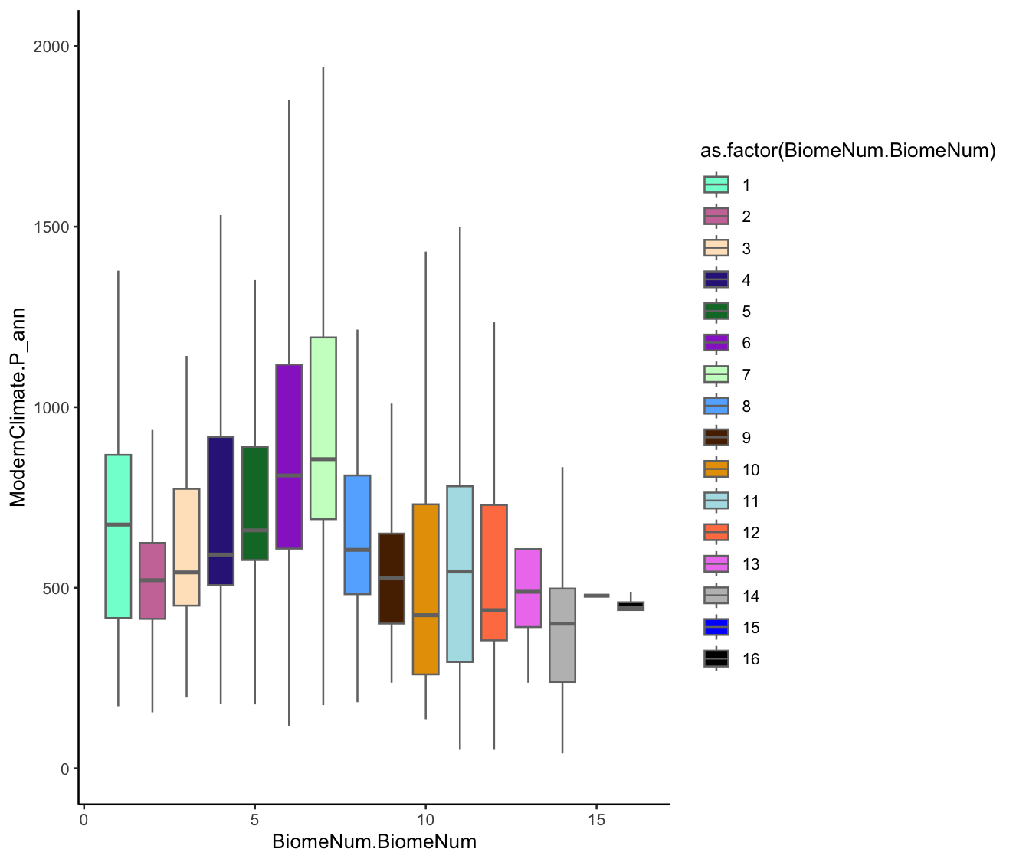
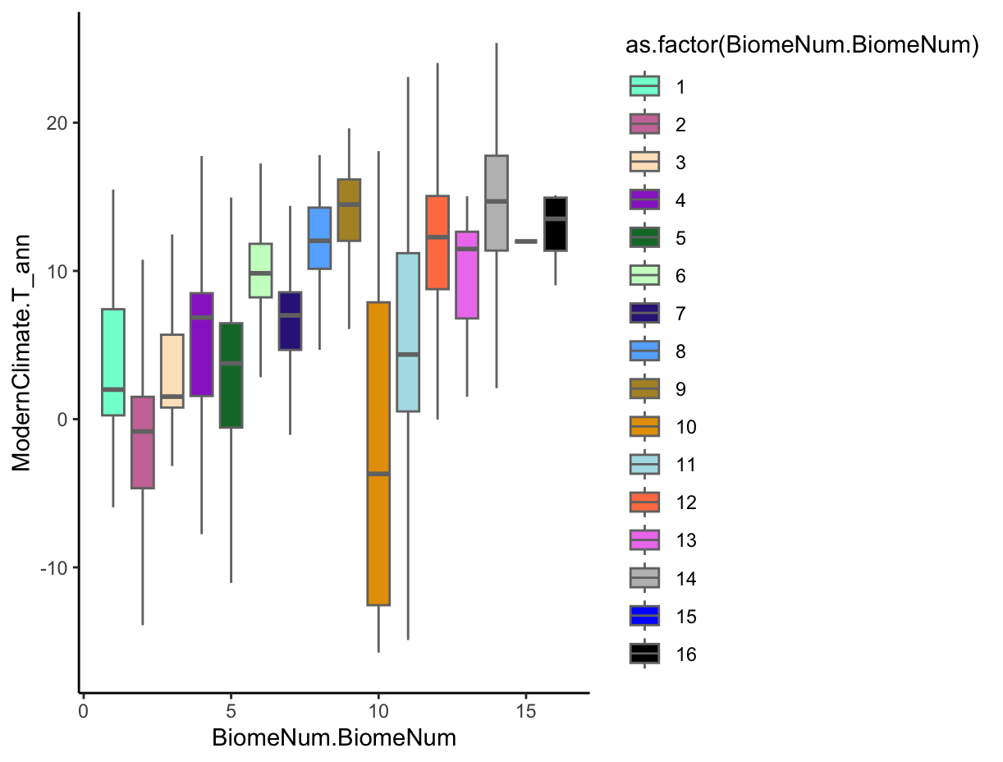
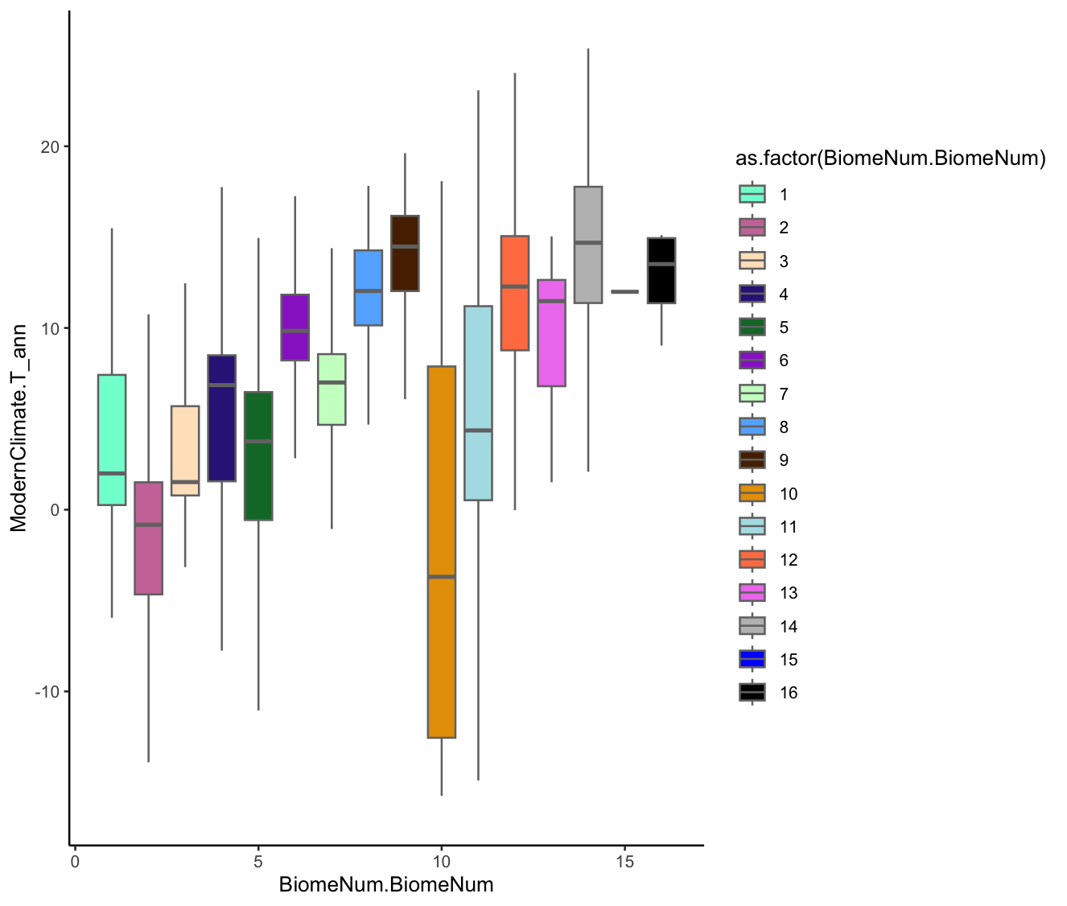
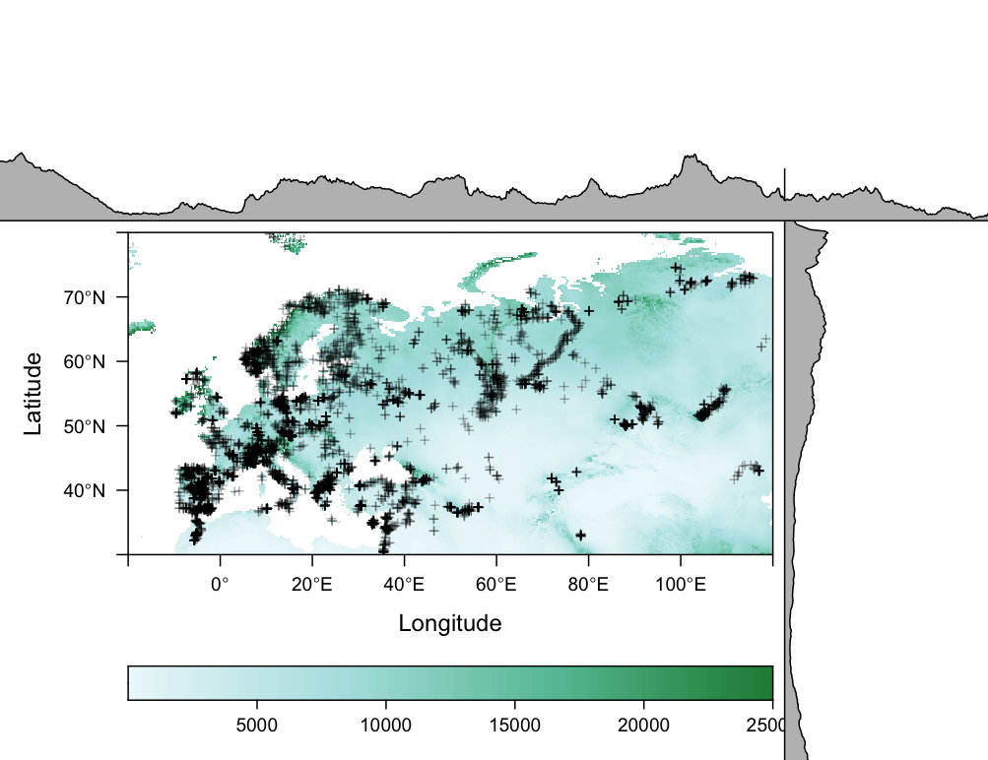
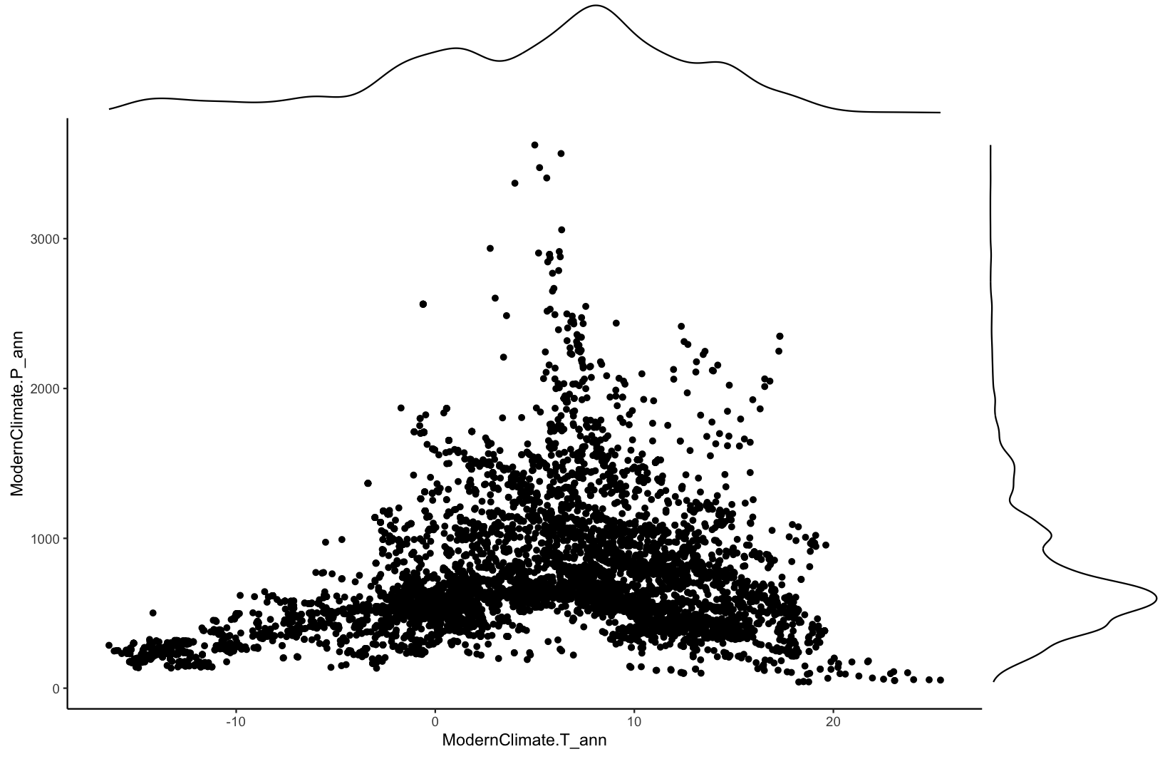
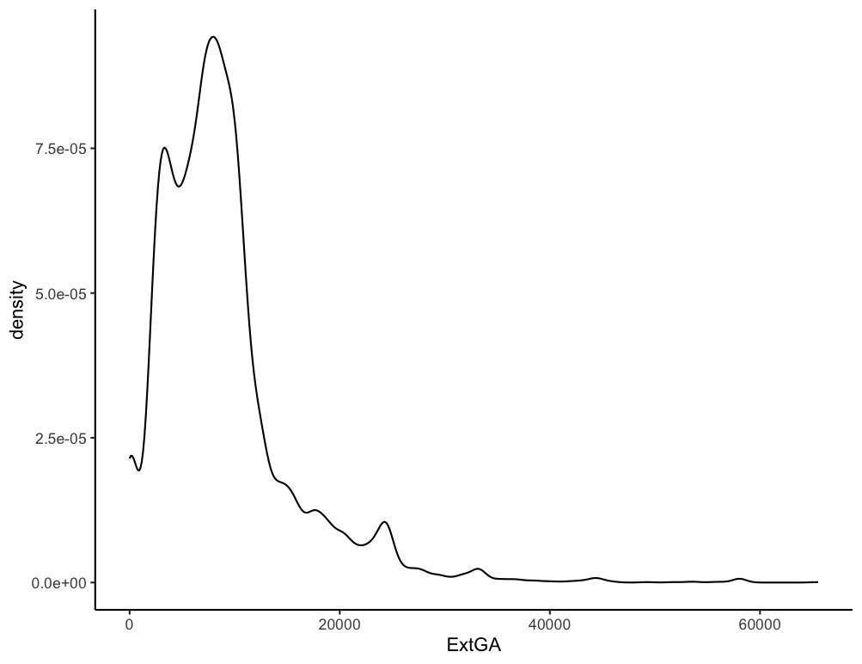
PANN (m/a)
TANN (°C/a)
0
0.5
1
1.5
2
-10
0
10
20
e. GA
3
PANN (m)
2
1
2
3
1
4
5
0
-10
0
10
20
TANN (°C)

Slide 5
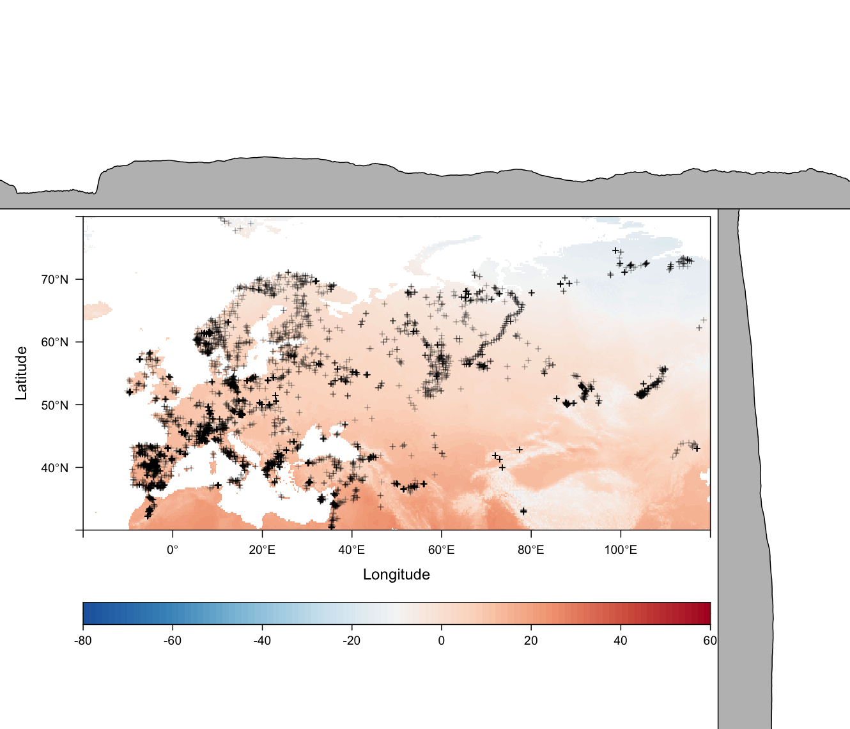
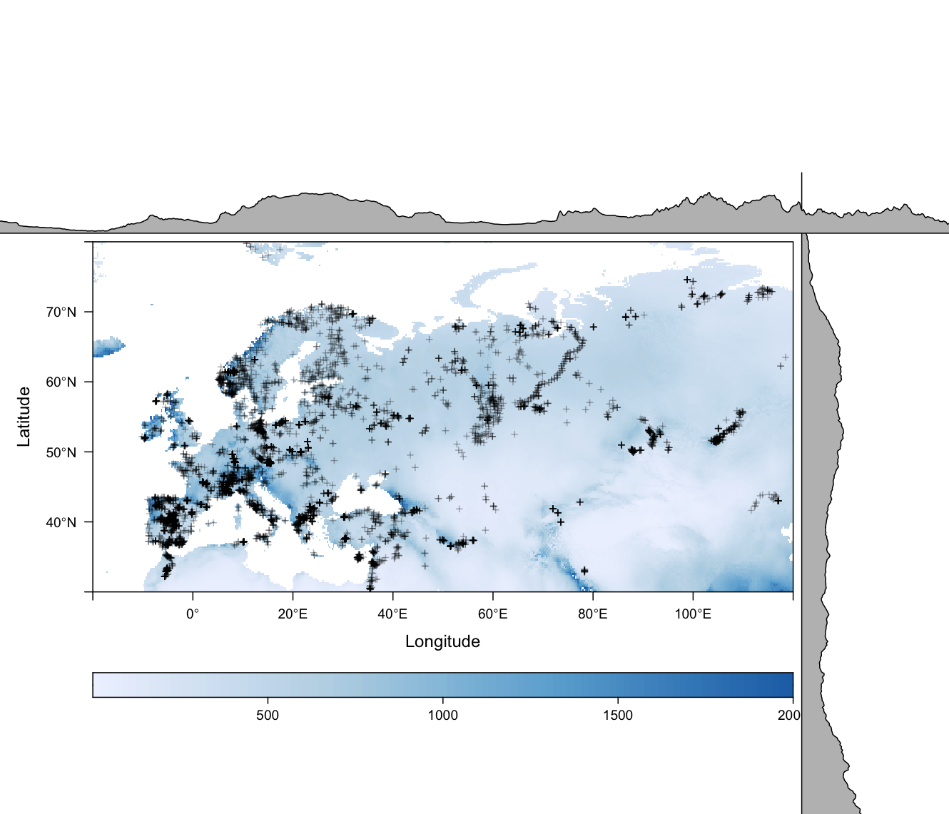
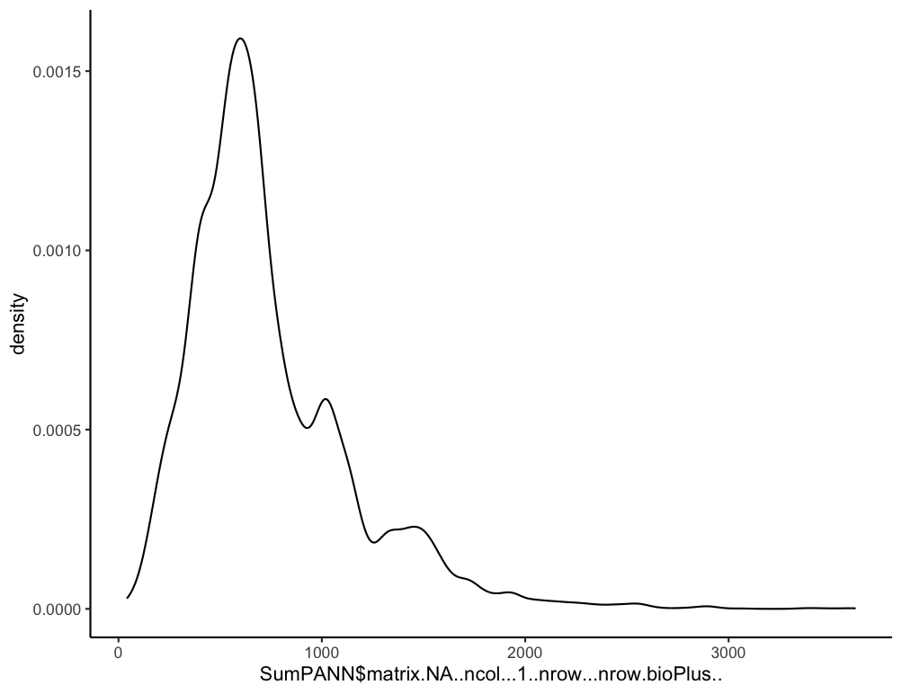
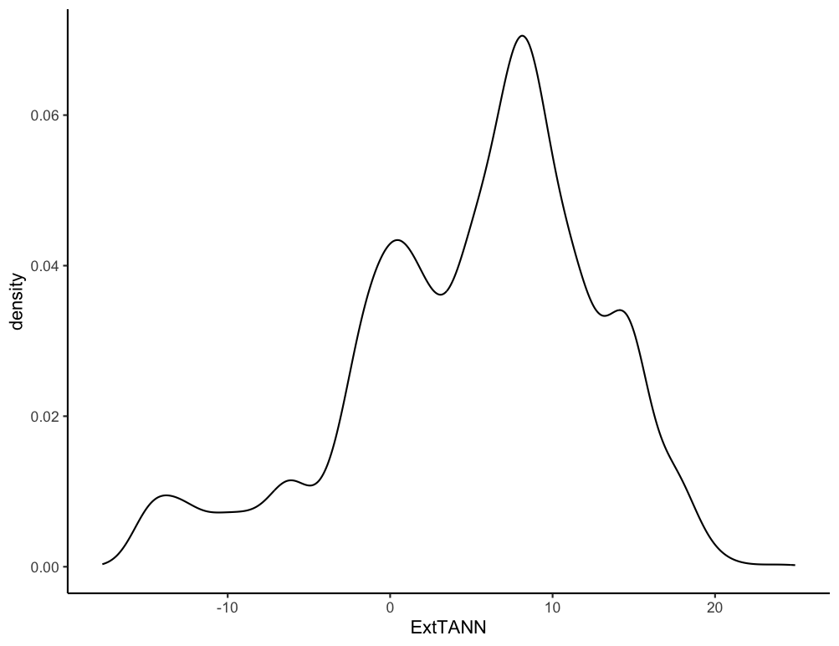
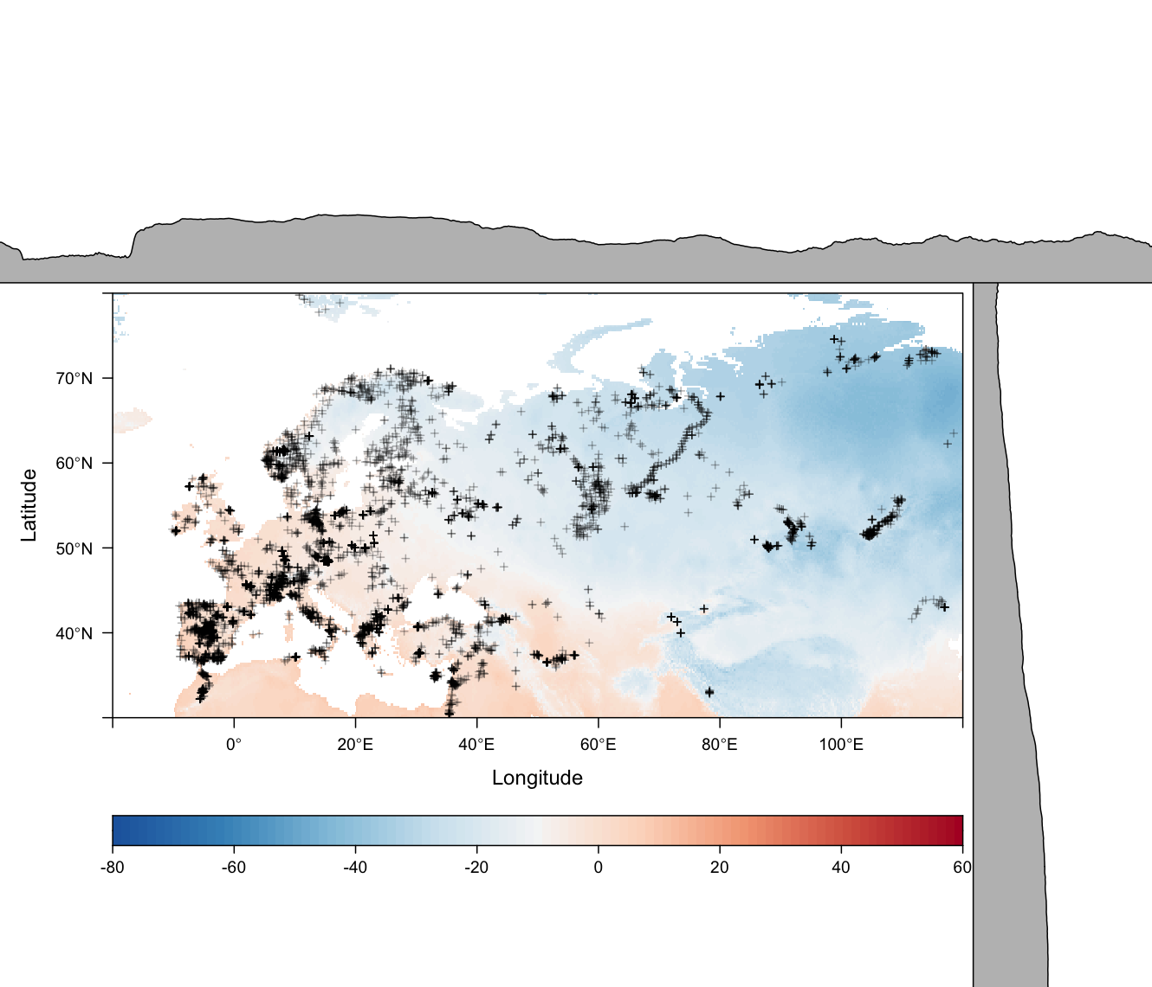
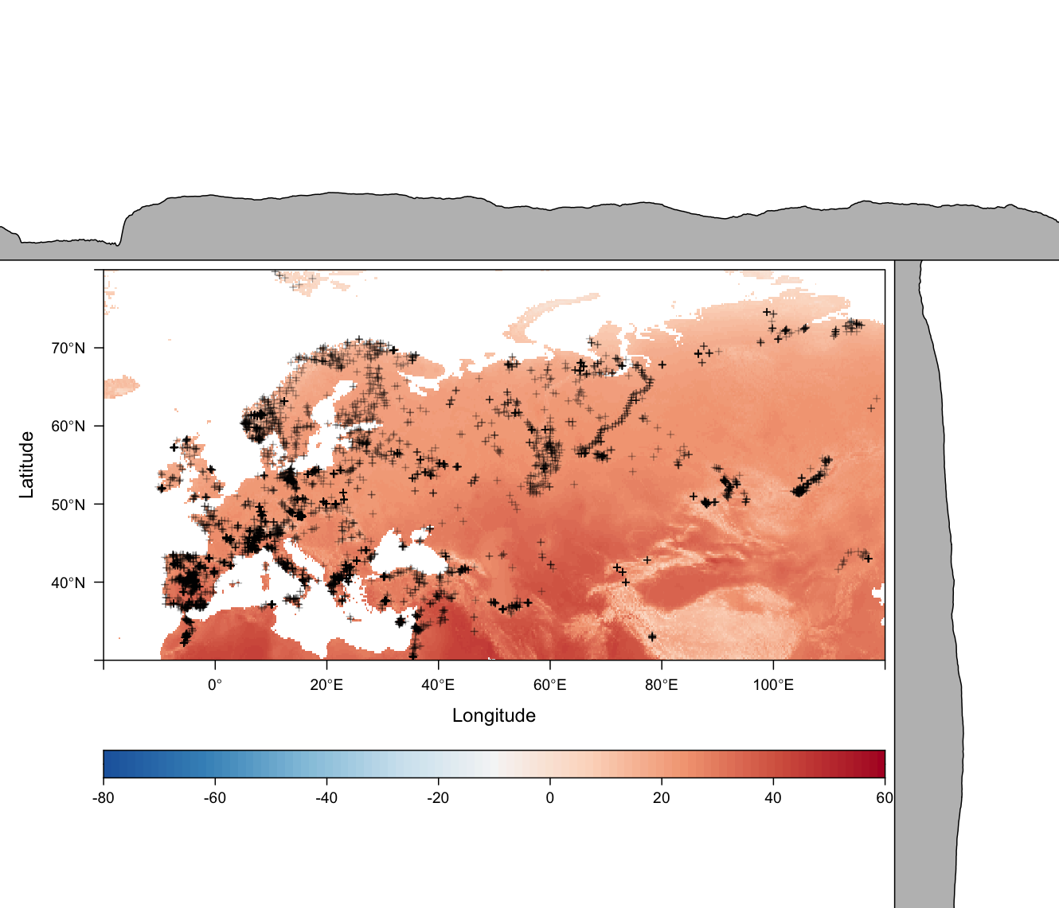
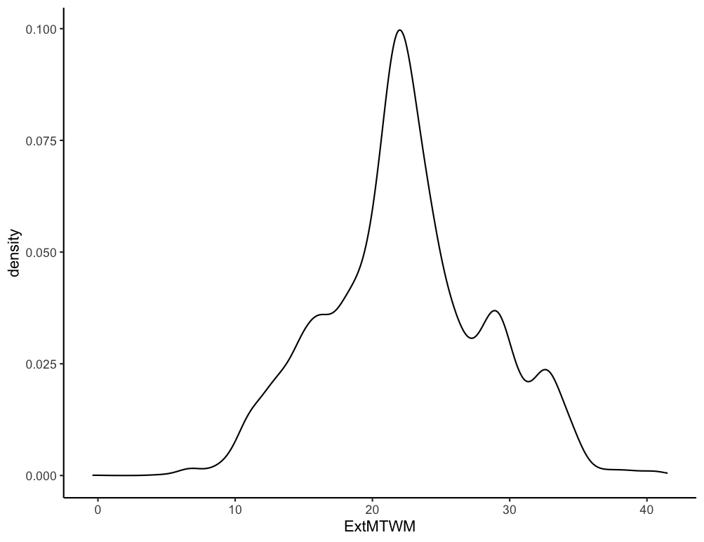
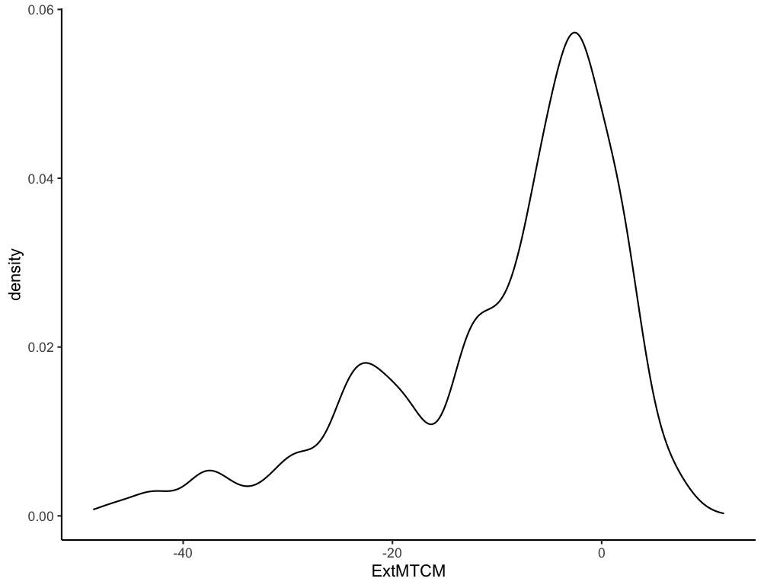
a. TANN
b. PANN
a. TANN
b. MTCM
20
3
10
2
0
1
10
0
c. MTCM
d. MTWM
0
d. MTWM
0
-20
20
-40
40
Temperature (°C)
Precipitation (m)
,
,

Slide 6
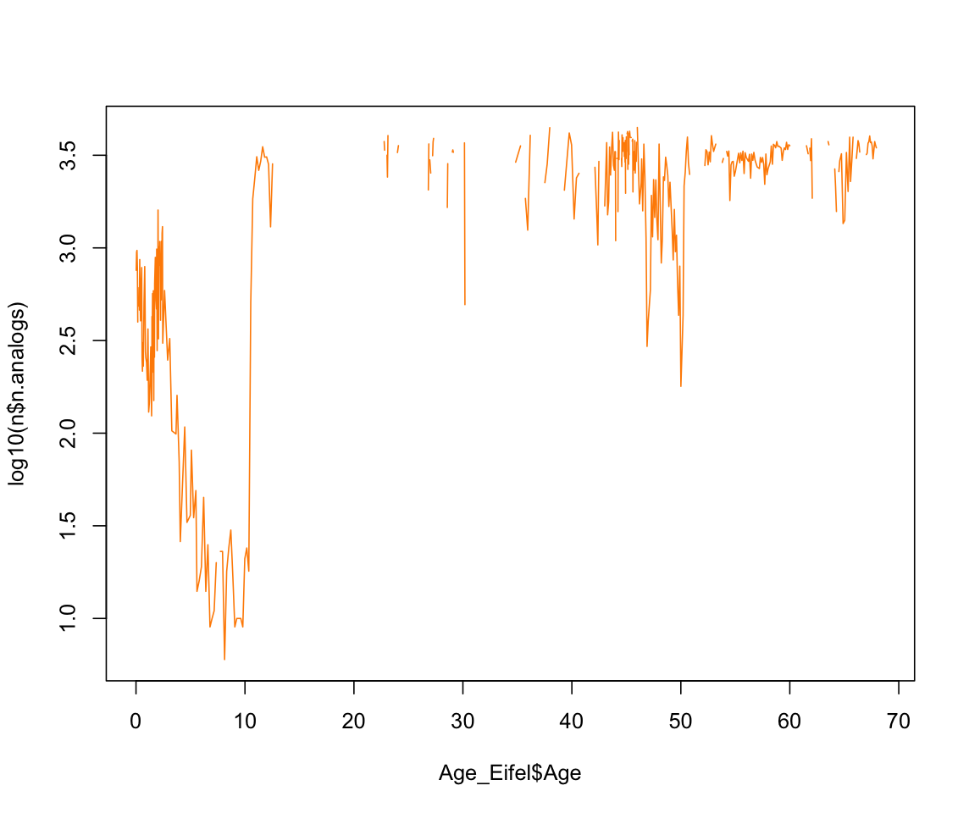
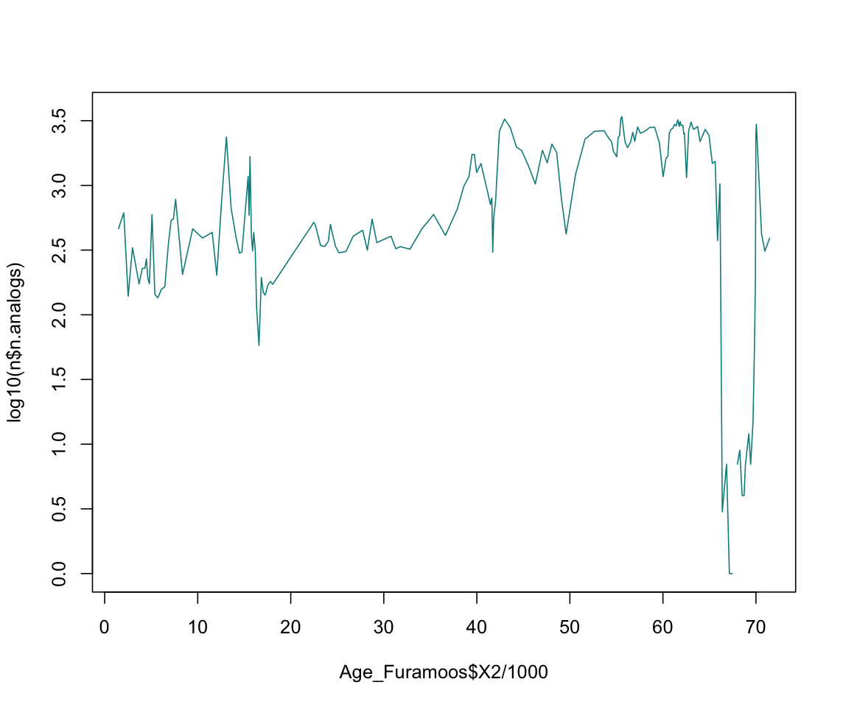
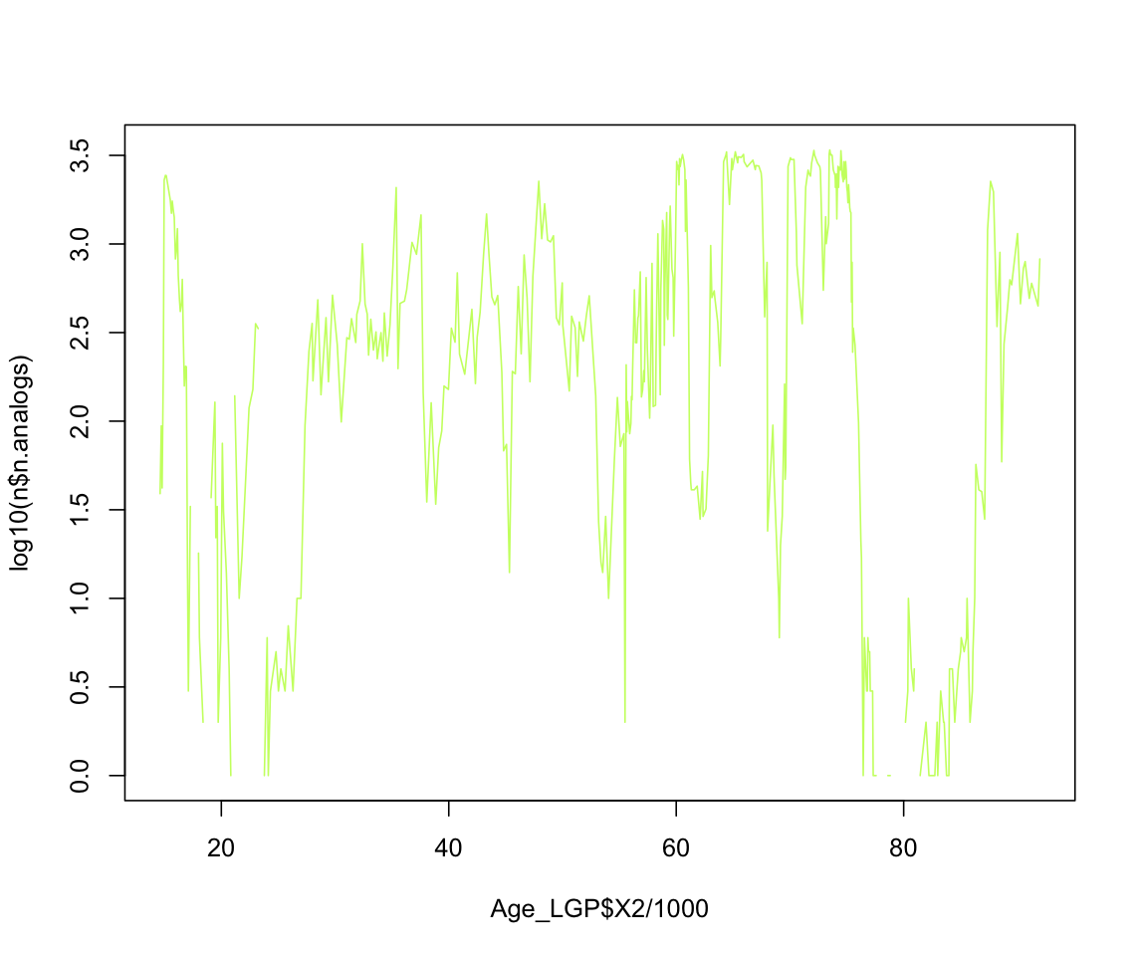
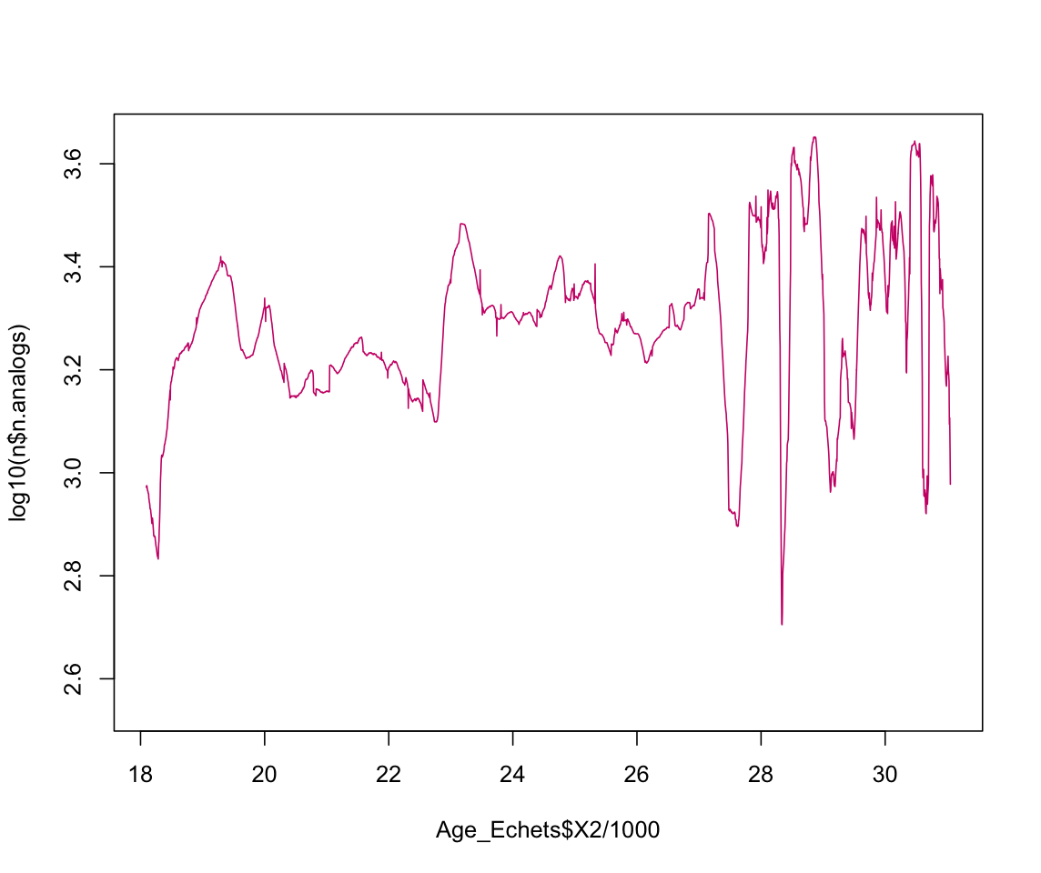
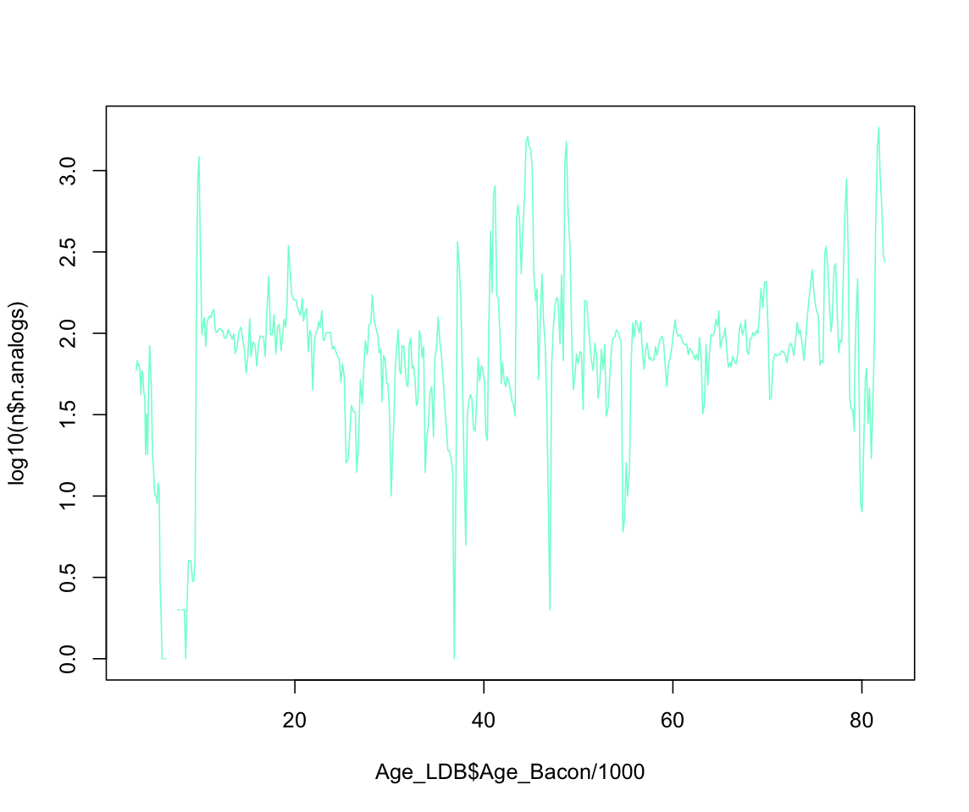
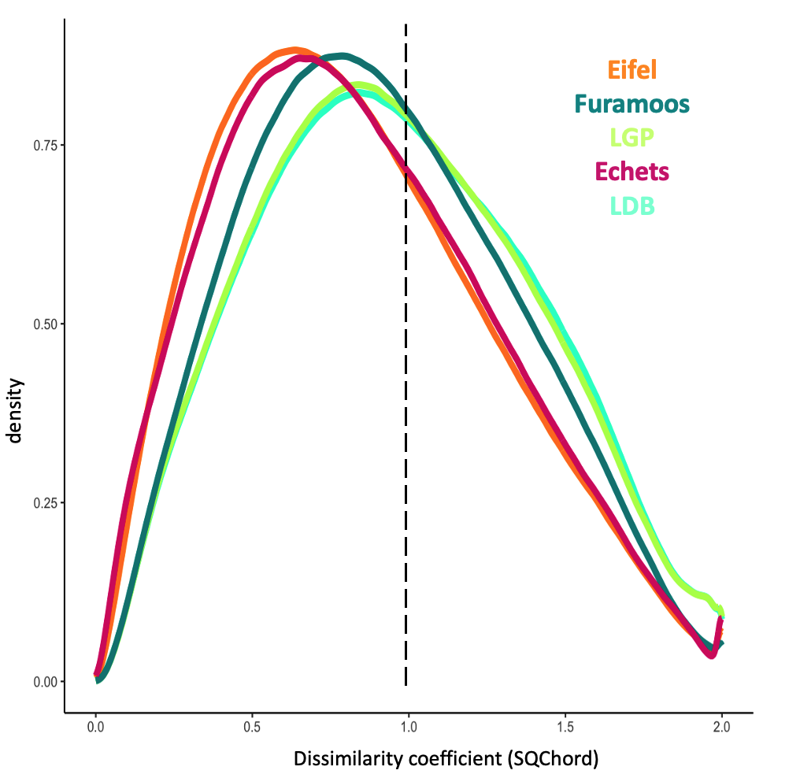
a.
b.
c.
log₁₀( nb.analogue)
Age (kyr)
Age (kyr)
Age (kyr)
d.
e.
0.75
log₁₀( nb.analogue)
0.5
densisty
0.25
Method=SQChord
Cutoff=0.4
K=5
0
0
1
2
Dissimilarity coefficient (Qchord)
Age (kyr)
Age (kyr)

Slide 7

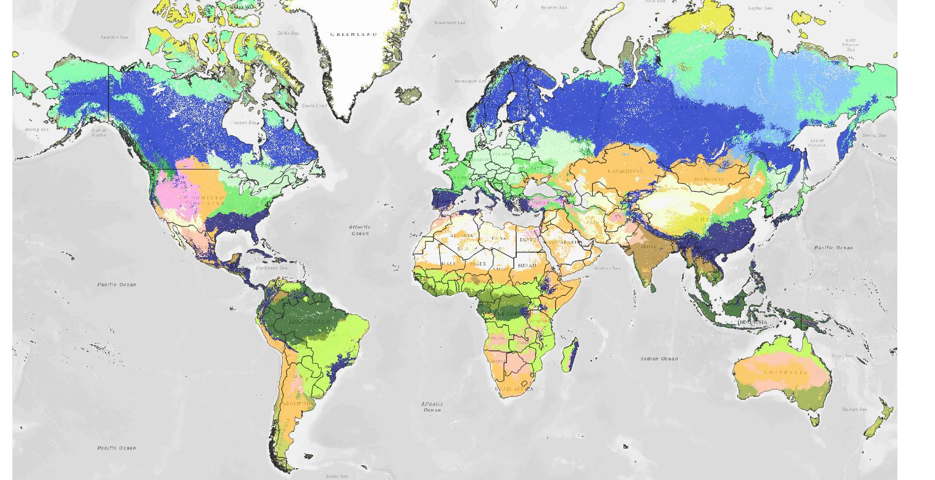
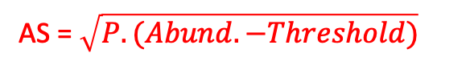
Biomisation – Méthode dérivées des PFTs
Workflow de la méthode
Biomisation ‘classique’ par score d’affinité moderne et fossile
Sous-ensemble de base de données après homogénéisation
Calibration des scores définies par biome
Biomisation sans score dominant = moyenne pondérée
Assimilation (i) des taxons à des PFTs
(ii) des seuils propres à chaque taxon pionnier
Estimation des scores d’affinité des taxons par spectres fossiles et modernes en matrice propre type covariance
Combinaison des scores des PFTs pour chaque biome
+ Vectorisation des scores selon dominance taxons entre biome
Hengl, Tomislav, 2018
Estimation des scores d’affinité des biomes par spectre fossile et moderne (scores dominants ou WA par abondance)
AS = $\sqrt{P. (Abund. −Threshold)}$
Mesure de dissimilarité entre échantillon et biome
Assimilation de chaque échantillon par biome
Calibration par matrice
de scores de biome

Slide 8
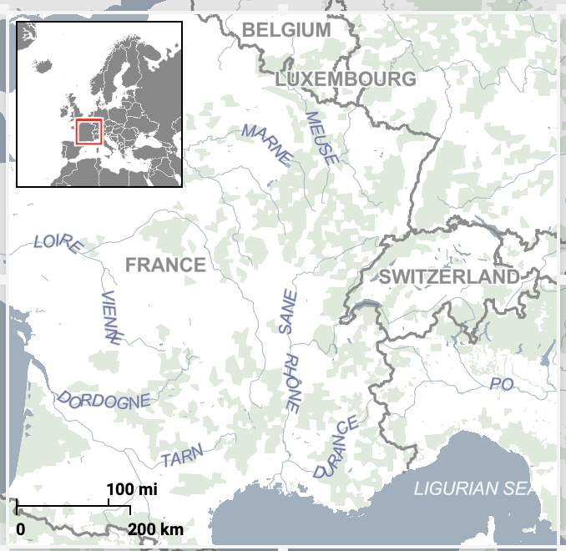
Number | Name (Latitude, Longitude, Elevation) | Core Pollen taxon occurrences Depth ranges Time period (cal BP) | References Pollen records Sediment dating
1 | Eifel (50°15’00’’N, 6°40’00’’E, 747 m) | ELSA-HM1 DE3 21 3-87 m 0-69 kyr | Sirocko et al., 2016 Sirocko al., 2013
2 | Füramoos (47°49’26’’N, 6°30’13’’E, 660 m) | FU 1, FU 3 46 0-14 m 0-42 kyr | Kern et al., 2021 Kern et al., 2021
3 | La Grande Pile (09°53’02’’N, 6°30’25’’E, 250 m) | GPXX 60 0-19 m 0-90 kyr | Guiot et al., 1989 Wolliard et al., 1981
4 | Les Echets (45°47’00’’N, 4°56’00’’E, 267 m) | D 21 0-30 m 17-35 kyr | De Beaulieu et al., 1984 De Beaulieu et al., 1984
5 | Le Bouchet (47°34’17’’N, 7°56’05’’E, 1 200 m) | G 56 0.9-16 m 18-82 kyr | Reille et al., 1989 Thouveny et al., 1989
1
Vosges
Jura
2
3
Massif
Central
4
5

Slide 9
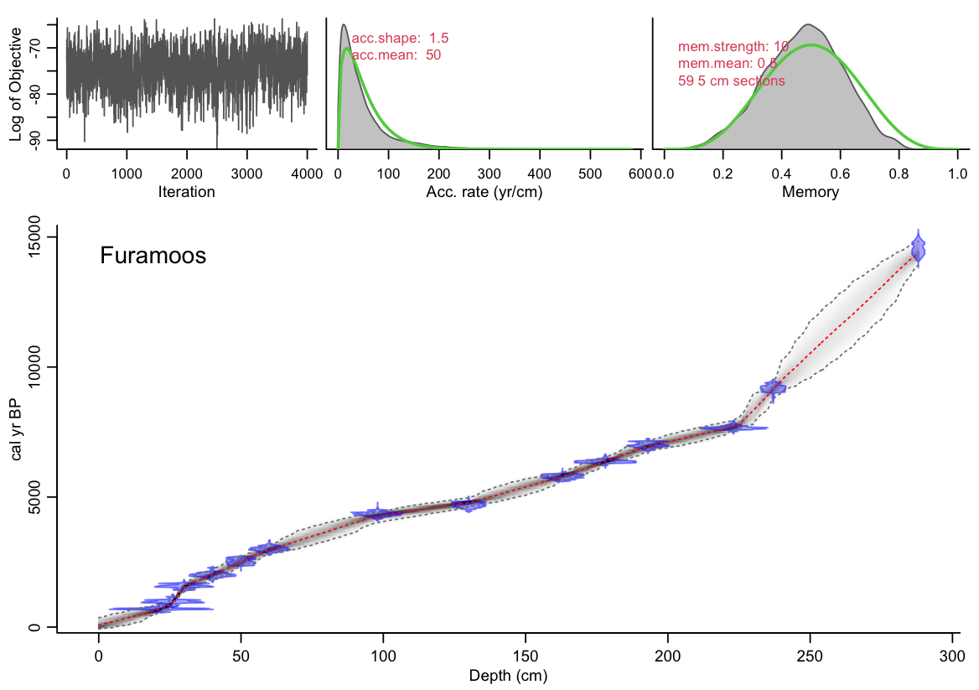
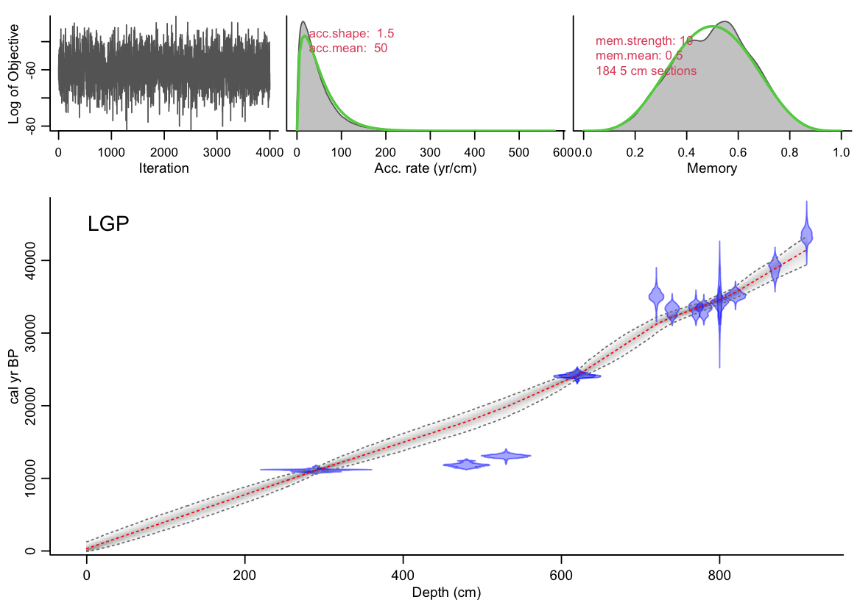
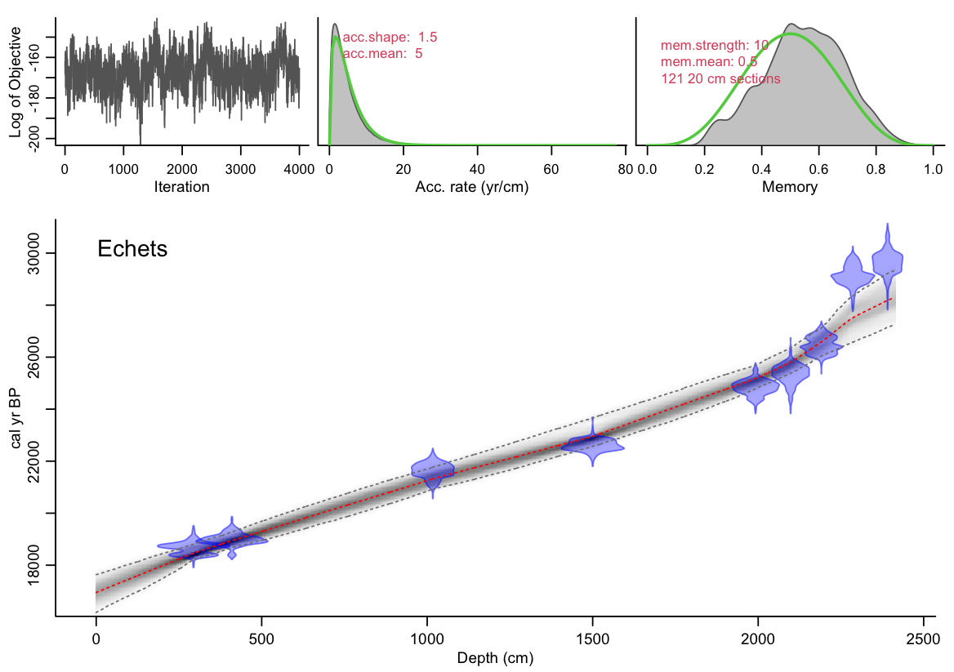
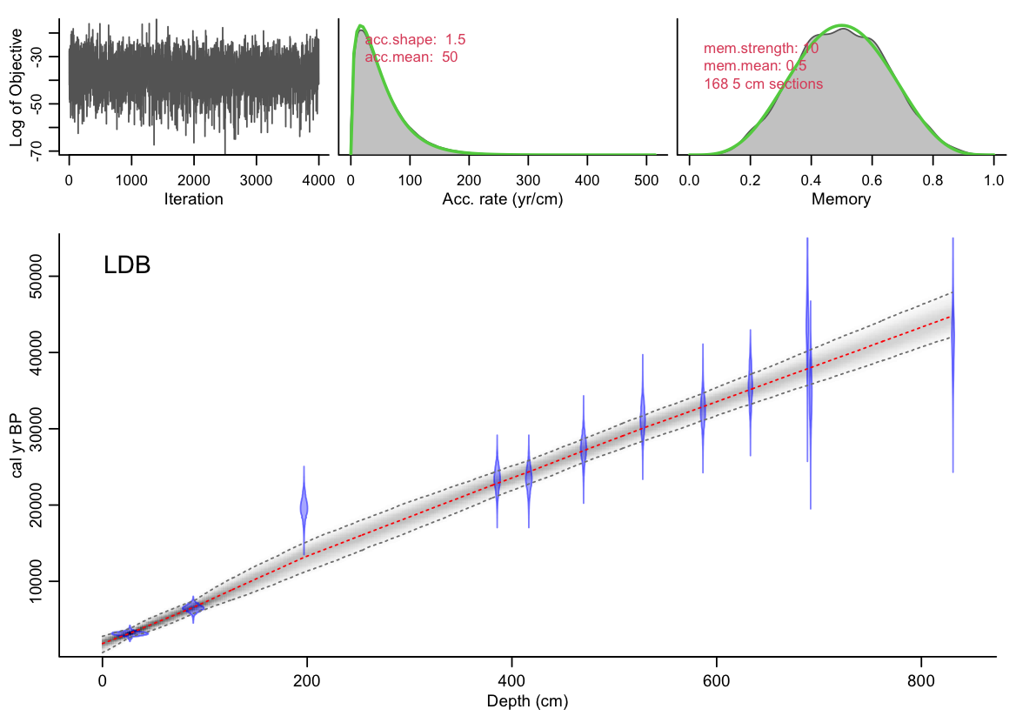
IntCal20: Northern Hemisphere (Reimer et al. 2020)
La Grande Pile
Furamoos
Echets
Le Lac Du Bouchet
Echets
Lac du Bouchet
Point de calage à discuter ?

Slide 10
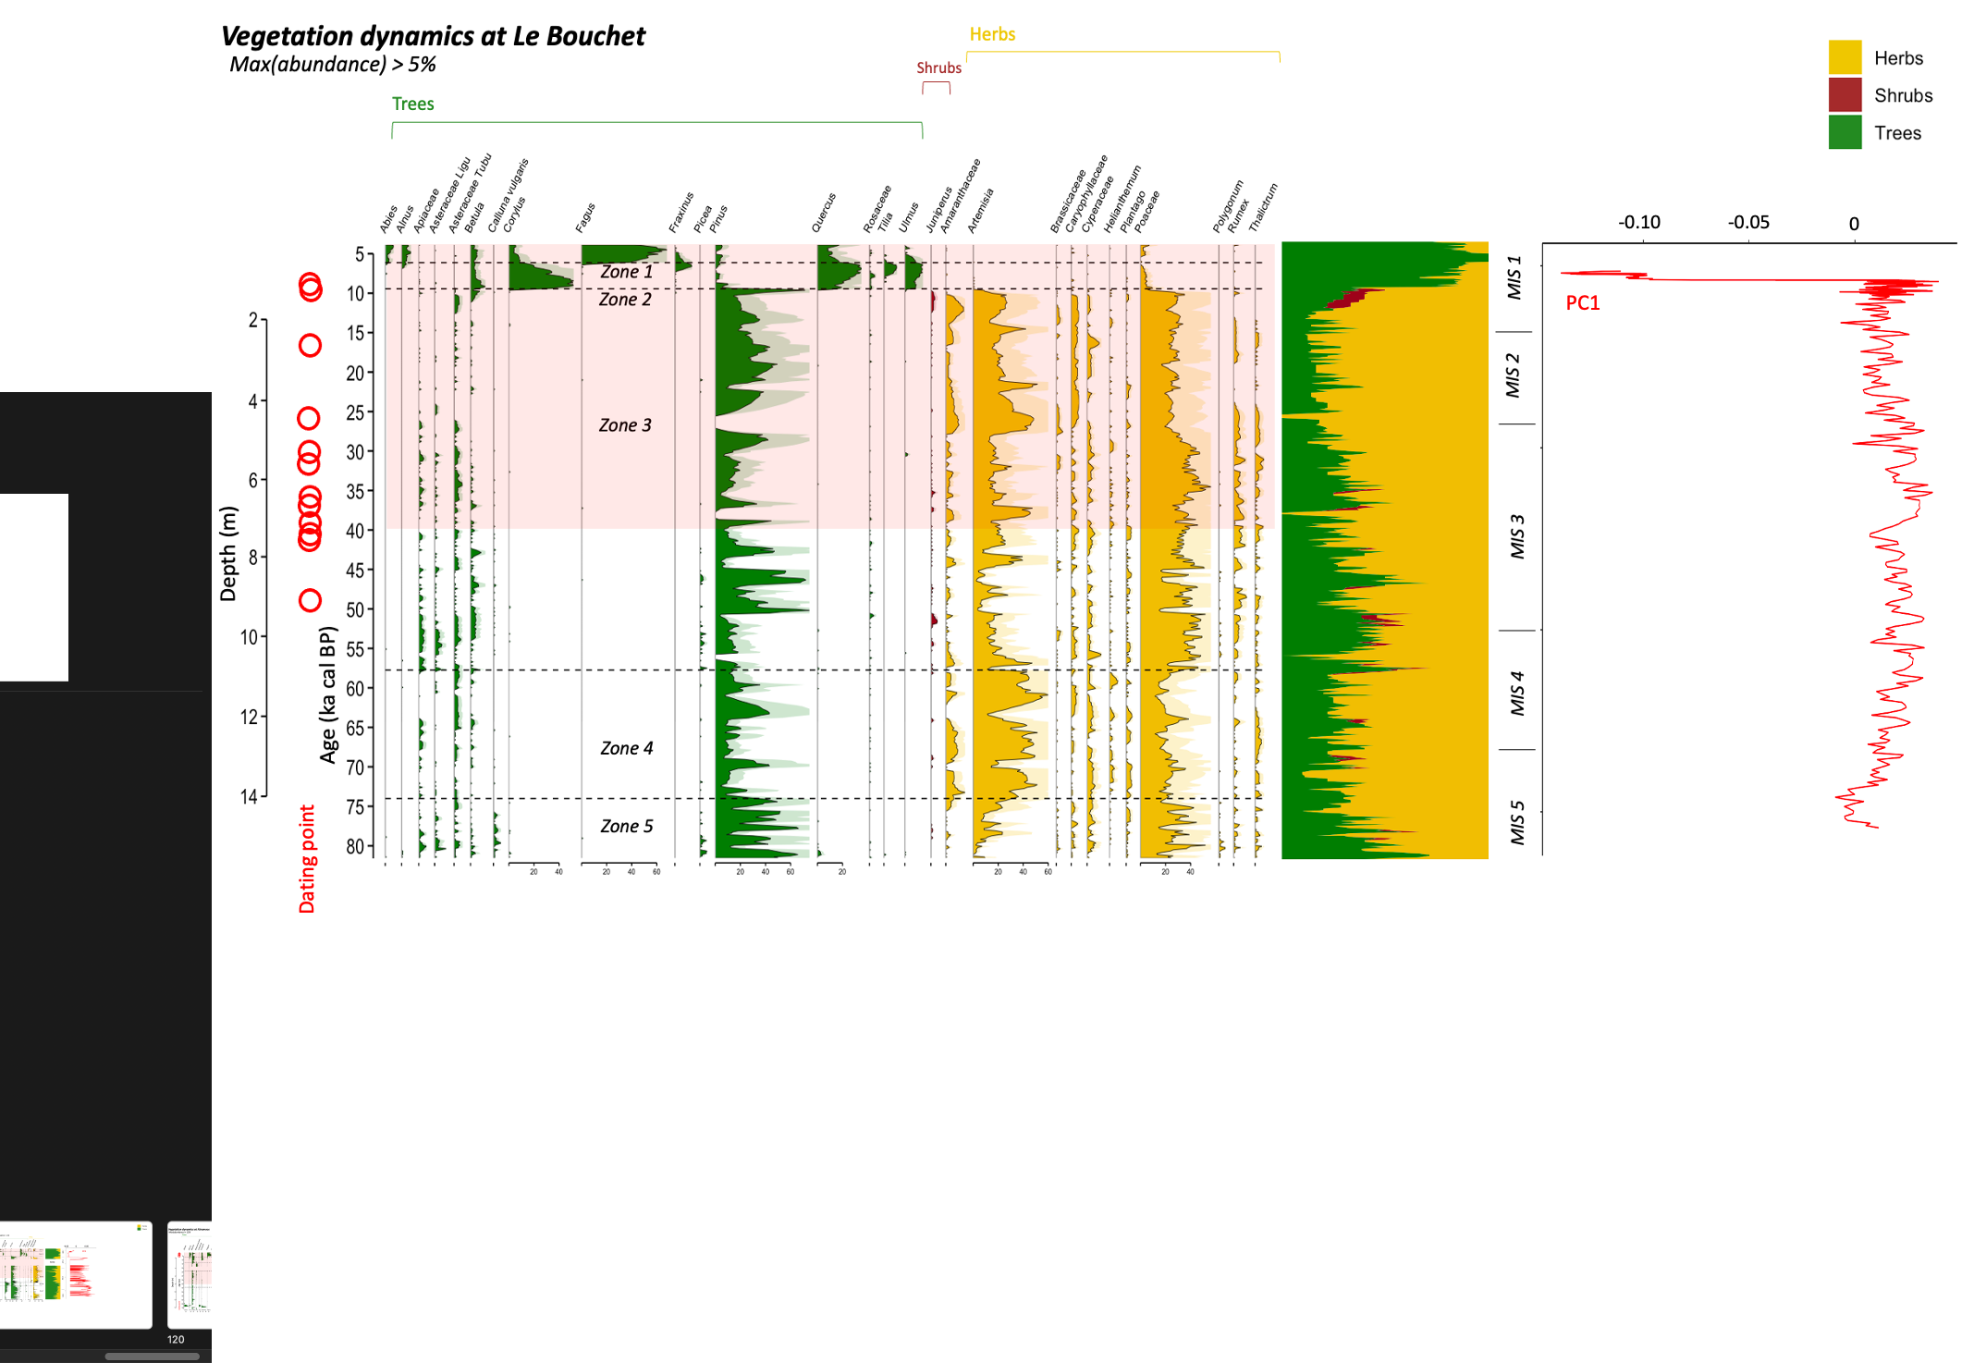


Slide 11


Slide 12


Slide 13


Slide 15












a.
b.
c.
Percentage (%)
Age (kyr)
Age (kyr)
Age (kyr)
d.
e.
a. Eifel
b. Füramoos
c. La Grande Pile
d. Echets
e. Lac Du Bouchet
Percentage (%)
Age (kyr)
Age (kyr)

Slide 16





a.
b.
c.
d.
a. Eifel
b. Füramoos
c. La Grande Pile
d. Echets
e. Lac Du Bouchet
f.

Slide 17




a.
b.
c.
Percentage (%)
Age (kyr)
Age (kyr)
Age (kyr)
d.
YD (11 kyr)
H1 (14 kyr)
H2 (23 kyr)
H3 (30 kyr)
e.
Percentage (%)
Age (kyr)
Age (kyr)

Slide 18






Inferred vs. Observed
Nb. Taxon = 56
Nb. Modern = 8446
Dist.method = sq.chord
Bootstrap=TRUE
Nb. Boot = 500
fitted
Leave-one-out errors
TANN
PANN
GA
Observed
f’(k) = 0 → k=5
f’(k) = 0 → k=6
f’(k) = 0 → k=6

Slide 19



Slide 20


Avec Cyperaceae
WAPLS non biomisé
MAT et CREST calibration locale
TANN
10
5
MAT
WA-PLS
CREST
0
10
5
0
TANN (°C)
15
10
5
0
10
5
0
0
10
Age (kyr)
20
30

Slide 21

Avec Cyperaceae
WAPLS non biomisé
MAT et CREST calibration locale
1.5
PANN
1
MAT
WA-PLS
CREST
0.5
1.5
1
0.5
PANN (m)
30
1.5
1
0
0.5
-20
1
0.5
0
0
10
10
20
30
Age (kyr)
20
30
Age (kyr)

Slide 22

Avec Cyperaceae
WAPLS non biomisé
MAT et CREST calibration locale
30
MTCM
10
MAT
WA-PLS
CREST
-20
20
0
MTCM (°C)
-20
30
0
-20
30
0
-20
0
10
Age (kyr)
20
30

Slide 23



Avec Cyperaceae
WAPLS non biomisé
MAT et CREST calibration locale
$×$10³
20
GA
15
MAT
WA-PLS
CREST
10
0
20
10
GA ($∅$)
20
10
15
10
5
0
10
Age (kyr)
20
30

Slide 24
Avec Cyperaceae
MAT, WAPLS et CREST calibration locale
TANN
MAT
WA-PLS
CREST

Slide 25

A venir …
Fossil sites (altitude) | $∆$LGM cooling (°C) | $∆$LGM precip (mm) | $∆$LGM Aridity Index ($∅$)
Eifel (747 m)
Furamoos (660 m)
La Grande Pile (250 m)
Echets (267 m)
Lac du Bouchet (1 200 m)

Slide 26
Annexe. Pollen taxon diagrams in 5 sites. Classification proposes 4 Classes: Arboral (AP), Shurb, No-Arboral and Aquatic vegetation.
Arboral vegetation (AP) | Shrub vegetation | Herbaceous vegetation (NAP) |  | Aquatic
Betula | Juniperus | Poaceae | Gentianaceae ind. | Myriophyllum
Pinus | Betula nana | Cyperaceae | Centaurea scabiosa, t.nigra, Centaurium, Gentiana & Swertia | Nymphae
Corylus | Caprifoliaceae t. Lonicera & Sambucus | Artemisia | Lamiaceae t. Mentha, Hedysarum & Teucrium | Alisma
Quercus | Ephedra t. distachya & fragilis | Brassicaceae | Plantago t. lanceolata, major, media & montana | Menyanthes
Ulmus | Ericaceae t. ind. & Calluna | Caryophyllaceae | Polygonaceae ind. | Potamogeton
Alnus | Hippophae | Chenopodiaceae/Amaranthaceae | Polygonum bistorta & t.aviculare | Sparganium
Tilia | Rhamnaceae t.Paliucrus & Ramnus | Helianthemum | Ranunculaceae t.Trollius | Lemna minor
Fraxinus excelsior | Ribes | Thalictrum | Rumex | Typha
Salix | Myrica | Ranunculaceae ind. | Sanguisorba minor
Hedera | Viburnum | Armeria | Saxifraga t. granulata & t.oppositifolia
Acer | Viscum | Boraginaceae t. Cerinthe & Onosma | Scrophulariaceae ind. & t.Euphrasia
Abies |  | Campanulaceae | Valerianaceae ind. & t.Valeriana
Carpinus |  | Cichorioidae | Urticaceae
Fagus |  | Crocus | Euphorbia
Larix |  | Dipsaceae/Caprifoliaceae t. Dipsacus & Scabiosa | Apiaceae ind., t.Heracleum, Hydrocotyle, Pimpinella, Seseli, Apium, Pleurospernum
Picea |  | Ericaceae t. Listera ovata | Filipendula
Rosaceae t. Prunus & Sorbus |  | Fabaceae ind., t. Lotus, Onomis, Trifolium & Genista | Sanguisorba officinalis

Slide 27
Annexe. Relationship between biome classification and mega-biome reported in Hegel et al., 2018. From this table, we test the relatability of our classification in this global spatial resolution.
Biome schema | Initial Biome classification | Mega biome Classification (Hegel et al., 2018) | Our original biome classification in Europe
tropical evergreen broadleaf forest | tropical evergreen broadleaf forest | tropical forest | NA
tropical semi-evergreen broadleaf forest | tropical semi-evergreen broadleaf forest | tropical forest | NA
tropical deciduous broadleaf forest and woodland | tropical deciduous broadleaf forest and woodland | tropical forest | NA
warm-temperate evergreen and mixed forest | warm-temperate evergreen broadleaf and mixed forest | warm-temperate forest | WAMX
cool-temperate rainforest | wet sclerophyll forest | warm-temperate forest | WAMX
cool evergreen needleleaf forest | cool evergreen needleleaf forest | temperate forest | COMX/COCO
cool mixed forest | cool mixed forest | temperate forest | COMX/COCO
temperate deciduous broadleaf forest | temperate deciduous broadleaf forest | temperate forest | COMX/COCO
cold deciduous forest | cold deciduous forest | boreal forest | CLMX/CLDE/TAIG
cold evergreen needleleaf forest | cold evergreen needleleaf forest | boreal forest | CLMX/CLDE/TAIG
temperate sclerophyll woodland and shrubland | temperate sclerophyll woodland and shrubland | savanna and dry woodland | TEDE
temperate evergreen needleleaf open woodland | temperate evergreen needleleaf open woodland | savanna and dry woodland | TEDE
tropical savanna | tropical savanna | savanna and dry woodland | NA
 | temperate deciduous broadleaf savanna | savanna and dry woodland | TEDE
xerophytic woods/scrub | tropical xerophytic shrubland | grassland and dry shrubland | XERO/WAST
steppe | tropical grassland | grassland and dry shrubland | XERO/WAST
desert | desert | desert | HODE/CODE/COST
graminoid and forb tundra | graminoid and forb tundra | dry tundra | TUND
erect dwarf shrub tundra | erect dwarf-shrub tundra | tundra | TUND
low and high shrub tundra | low and high shrub tundra | tundra | TUND
prostrate dwarf shrub tundra | prostrate dwarf-shrub tundra | tundra | TUND

Slide 28

Annexe. Comparison between five pollen and climate reconstruction results for each reference period of time, in terms of altitude, class of vegetation, dominant biomes and reconstructed climate variables from 2 methods. Error of the climate parameters are 2$σ$.
Chronological reference period Fossil site | Altitude (m a.s.l) | Pollen fraction per vegetation class (%) |  |  | 3 dominant biomes (scores) (1) | TANN (°C) | PANN (mm) | GA ($∅$)
 |  | AP | Shrub | NAP
Younger Dryas ($\sim$11 kyr)
Eifel | 747
Füramoos | 660
La Grande Pile | 250
Echets | 267
Lac du Bouchet | 1 200
H1 ($\sim$14 kyr)
Eifel | 747
Füramoos | 660
La Grande Pile | 250
Echets | 267
Lac du Bouchet | 1 200
H2 ($\sim$23 kyr)
Eifel | 747
Füramoos | 660
La Grande Pile | 250
Echets | 267
Lac du Bouchet | 1 200
H3 ($\sim$30 kyr)
Eifel | 747
Füramoos | 660
La Grande Pile | 250
Echets | 267
Lac du Bouchet | 1 200

Slide 29












CREST outputs/biome LDB

Slide 30



